Slide 1
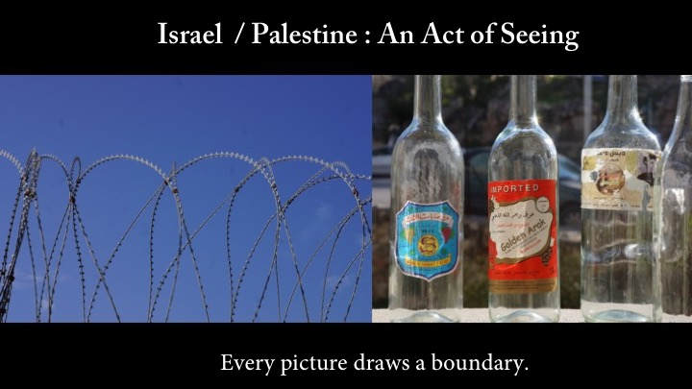

Slide 2
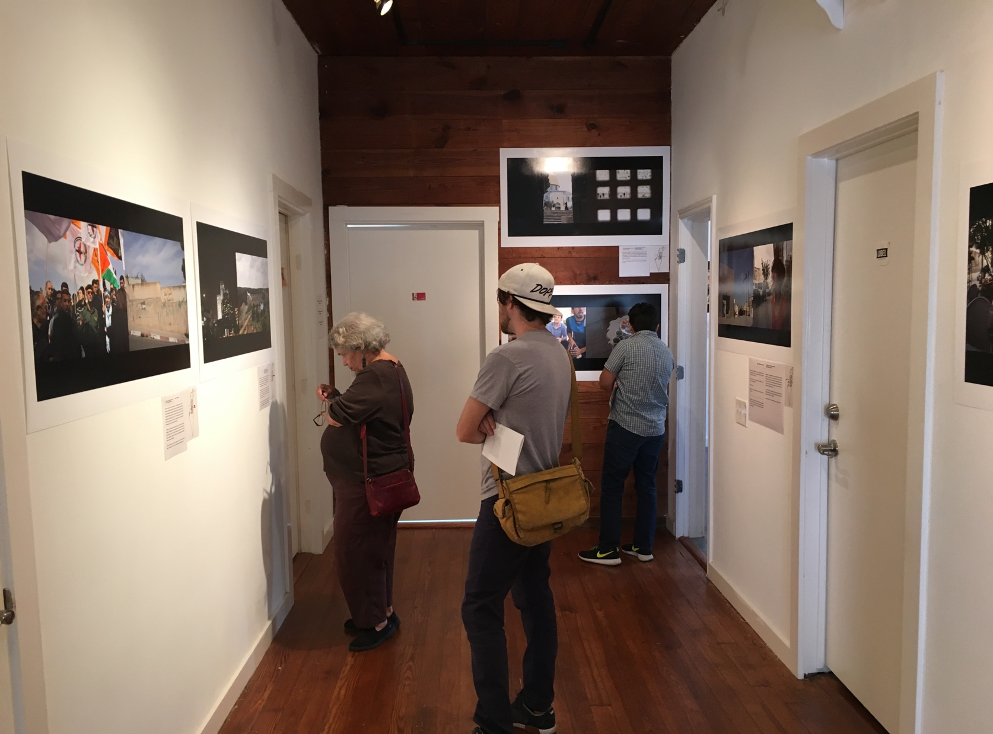
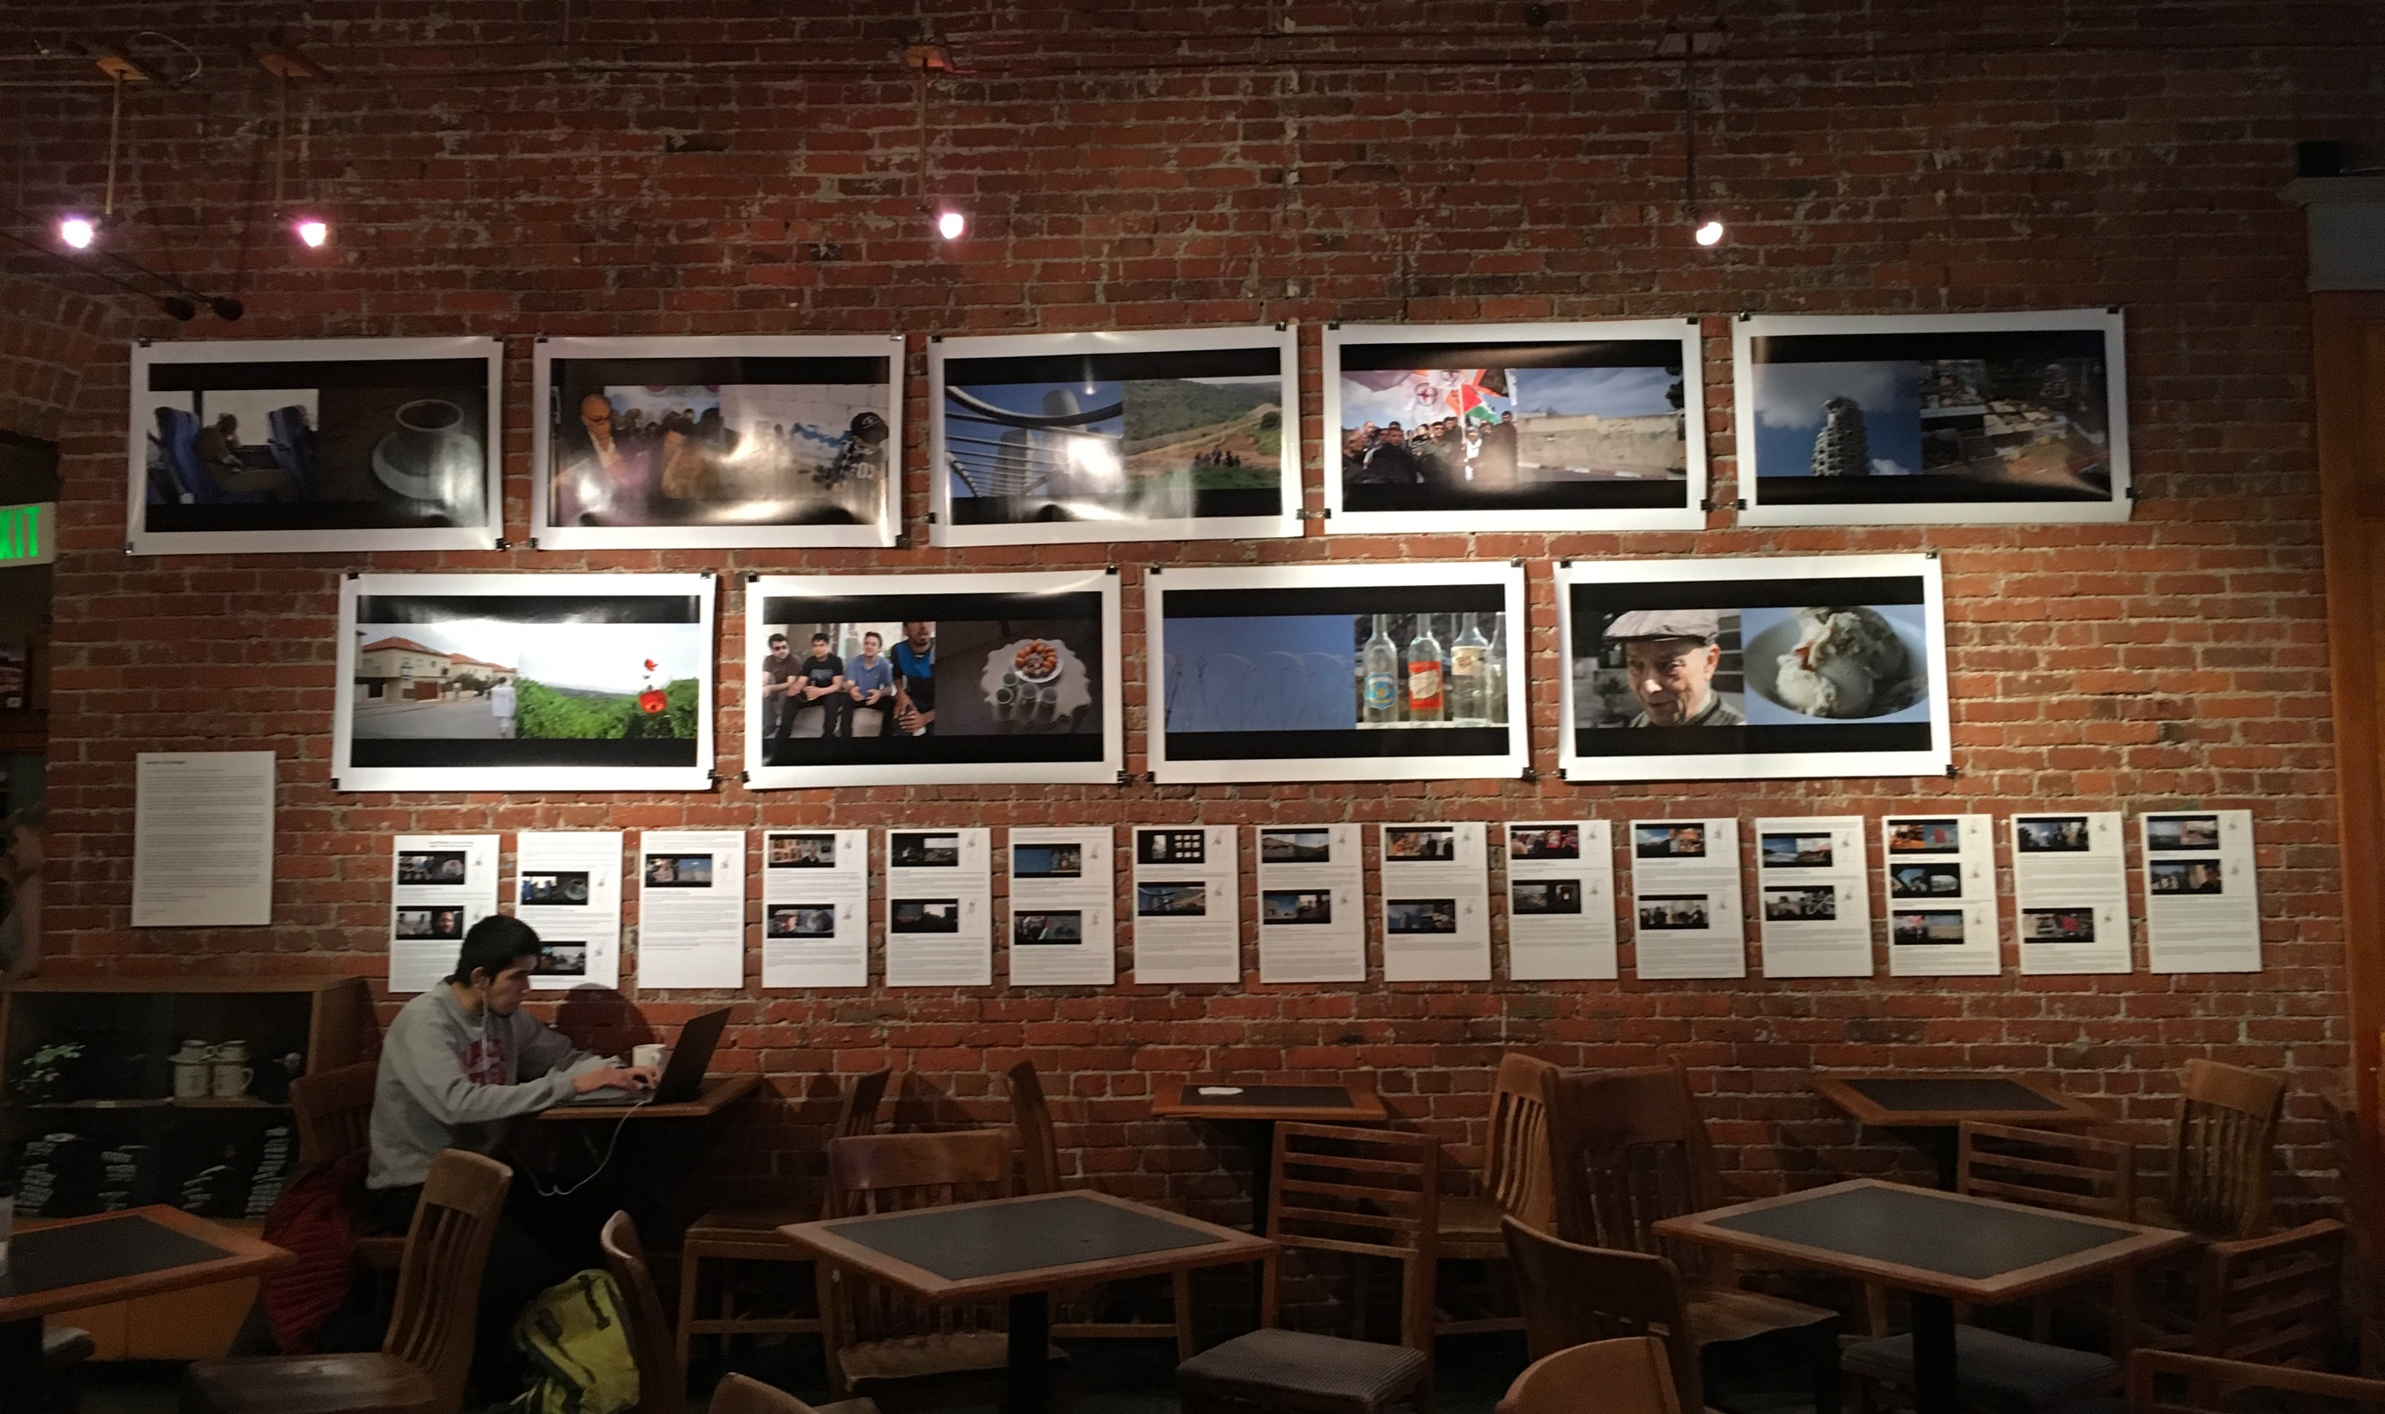
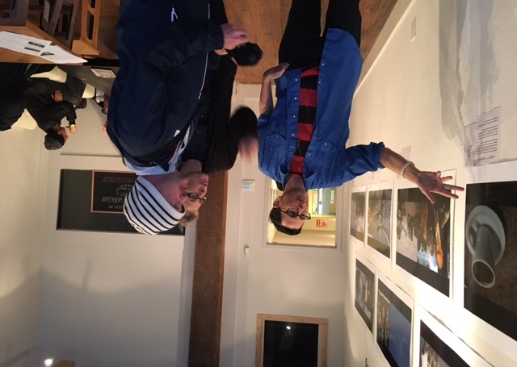
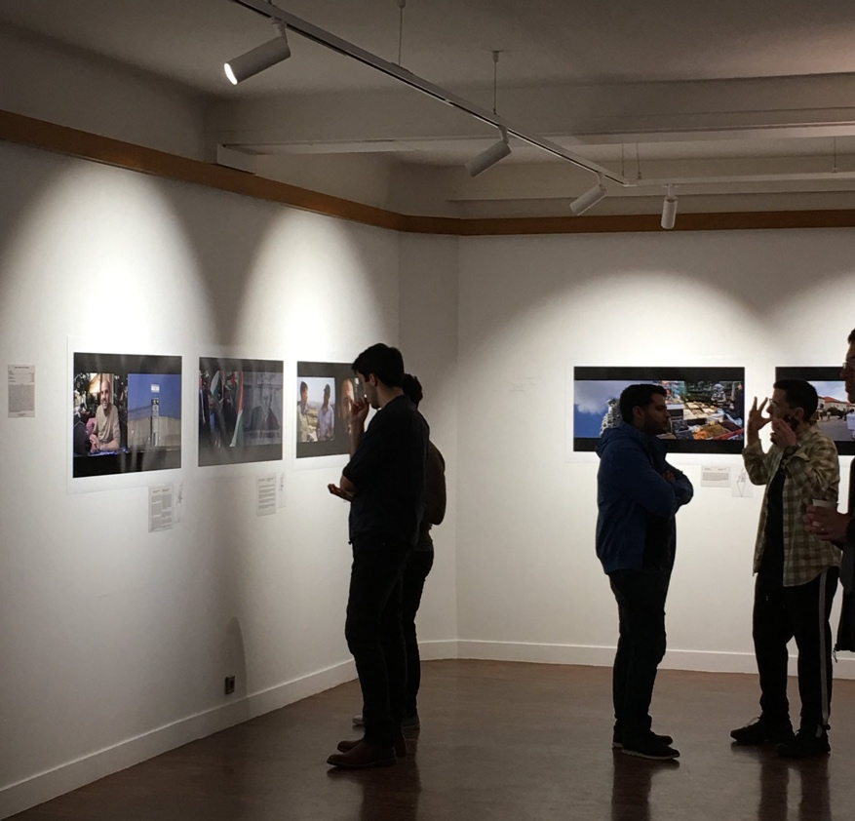
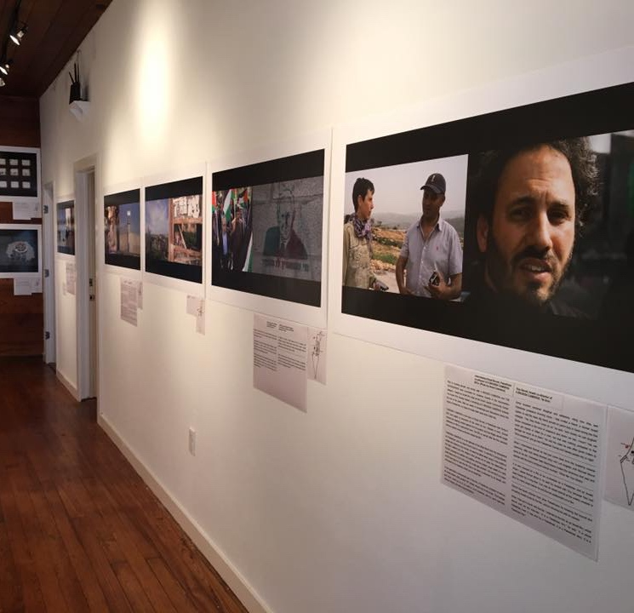
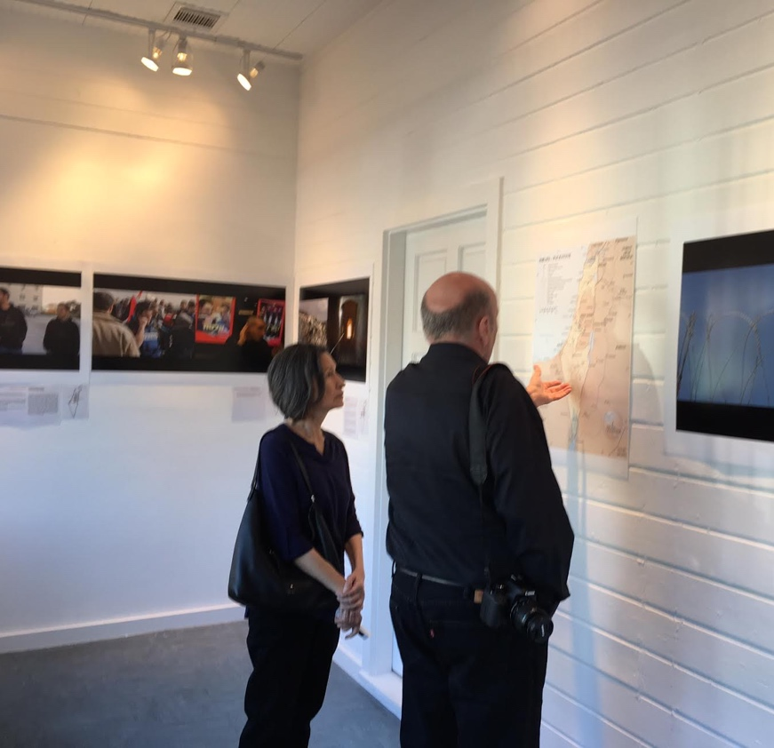

Slide 3
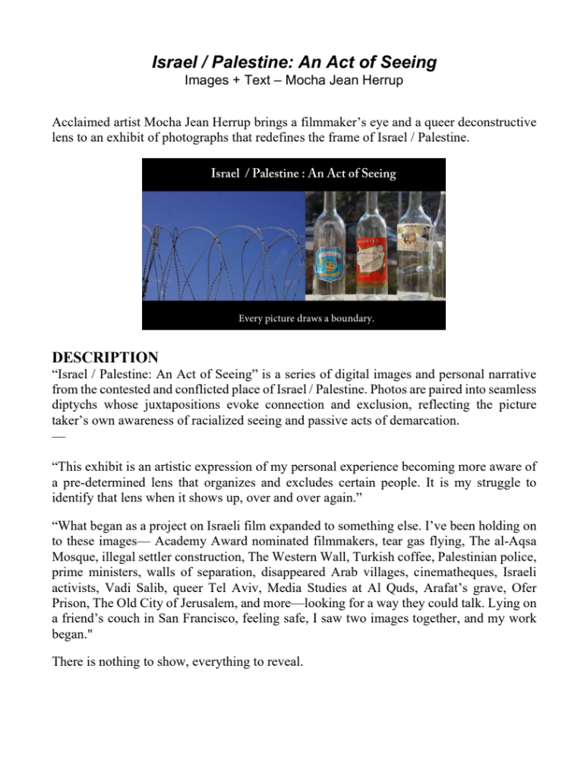

Slide 4
ARTIST STATEMENT
I am a queer Jewish filmmaker, writer, performer, and professor.
Raised in an observant Jewish family with a dad who worked as an executive director for several Jewish Community Centers, I went to Hebrew school three times a week; Had a Bat Mitzvah at 13 and read from the Torah (not customary for girls); Traveled to Israel as a teen on a trip sponsored by my congregation; Studied Hebrew in college; Grew up in a community of lifelong learners; Convinced Magnolia Café, in 2006, to permanently add lox and bagels to the menu.
I traveled to Israel / Palestine in 2013 to research Israeli film. Through my connections with international communities of filmmakers, festival programmers, academics, artists, activists, and OK Cupid enthusiasts, I traveled back and forth between the State of Israel and the occupied West Bank (Ramallah, parts of Jerusalem, and Bil’in).
It is painful to admit but when I began my research, Palestinian film was not part of the project. Not because I didn’t know it existed. I have seen, admired, and studied work by Elia Suleiman, Hany Abu-Assad, and Michel and George Khleifi, but in my mind there was a separation. I thought it possible to focus on one and not the other, and I now understand how that is no longer possible.
The people living in this region have a shared, bitterly contested history. So contested it is impossible to refer to the land using nomenclature that is not ideologically loaded. “Israel” and “Palestine” mean different things to different people, and when you refer to one and not the other, you are taking a side.
How you see the land is in itself an ideological act. Am I looking at a beautiful forest built with trees provided by the American Jewish National Fund, or am I looking at a place that was once an Arab village? Am I in a Jewish suburb just east of Jerusalem, or am I in the West Bank? Am I researching a successful film industry in which many great artists find support, or am I researching an industry that, regardless of intent, can be a tool of distraction, normalizing an occupation of more than four million Palestinian people.
To focus on Israel without Palestine perpetuates the myth that Israel and Palestine are separate. This practice is an act of exclusion and erasure, and I no longer wish to participate in that act. I present photos in this form, as images that are always, in some way, connected to another vision, and that would always, in some way, do something different if presented on their own.
It was a complicated trip.
It didn't change my politics. It changed the way I see.
Because I saw how I was seeing.
Mocha Jean Herrup
Austin, Texas
2016

Slide 5
PROJECT UPDATE
Since I first installed this project in 2016, much has happened. Some Israelis and hundreds of Palestinians have died in conflict; Benjamin Netanyahu was re-elected Israel’s Prime Minister and once again charged with bribery and corruption by the police; The construction of illegal Jewish Israeli settlements in the West Bank continues to increase; Salam Fayyad, Prime Minister of the Palestinian Authority, resigned citing Palestinian division and Israeli intransigence; Legislation to make it illegal to boycott Israel has been introduced in the US Congress; And white nationalism has gained power in the US with increased violence and discrimination against Muslims, immigrants, Blacks, and other People of Color. In other words, nothing has changed, it’s only gotten worse.
There has been a tipping point around separating a critique of Israel from claims of antisemitism, and more Jews and allies are making clear that Zionism is not synonymous with Judaism. In the aftermath of the tragic slaying of eleven Jews at Pittsburgh’s Tree of Life Synagogue (where my cousin Elaine, for whom this project is dedicated, was married), Jews and allies on the ground united to blame the violence on the rise of white nationalism, not an exceptionalist form of antisemitism. While many in the mainstream Jewish community in the US and Israel’s right-wing government used the tragedy to further justify the need to support a Jewish State, many other Jews, particularly those in Pittsburgh, responded by demanding “safety through solidarity,” arguing against the idea that increased militarization in Israel and the US and unwavering support for Israel’s occupation of 4.4 million Palestinians is “good for the Jews.”
Since the premiere of this project at the Prizer Gallery in Austin Texas, “Act of Seeing” appeared at the Austin Community College and the Qulture Collective in Oakland, CA, and will travel this June to Paris, France to Nanterre’s City Gallery. Wanting to reach other Jews with the project, I’ve approached several organized Jewish spaces (Jewish Community Centers, Reform Jewish congregations, Hillel, etc.) with similar results– a polite response stating interest, a link to more information about a 2 state solution, and an unwillingness to set an actual date for the project to be installed.
­
Personally, I’ve become more clear and open about my critique of Zionism as a colonial movement, and I continue to become more aware of my own implicit biases and my role in maintaining a system of racist oppression. I remain vigilant in my work to recognize and dismantle the racialized lenses through which I see the world, as these structuring frameworks appear over and over again. The word, “antisemitism,” no longer appears in this project as “Anti-Semitism,” reflecting an awareness that the category, “Semite,” was created within a system of scientific racism. After a kind and humbling interaction with a viewer in Oakland, I changed references to “occupied Palestinians” to “Palestinians living under occupation.”
I happened to be at my parents’ house in New Bedford, Massachusetts when the slayings in Pittsburgh occurred. My mother, a second generation Jewish-American born during WWII, responded. “Antisemitism is alive and well. We had a brief golden age in this country and now it’s over. We say ‘never again’ but I don’t believe it.” She is convinced there will be another Holocaust. I don’t disagree. But like the one before I tell her, it won’t just be for Jews.
She does not want to see the connections– how things getting better for Jews in the US is linked to things becoming worse for others, particularly People of Color. “Things did get better for Black people,” she says, “just not as good as they did for us,” as if white supremacy had no role in that separation and subsequent elevation, as if Jewish acceptance was not predicated on becoming white, as if anyone is ever truly safe in a system of racial oppression.
––––––––
I continue to move forward with this project, updating and expanding the text, reaching out to Jewish spaces, printing and reprinting.
Also, I left Texas and moved to Seattle.
-Mocha Jean Herrup
Seattle, Washington
February, 2019

Slide 6
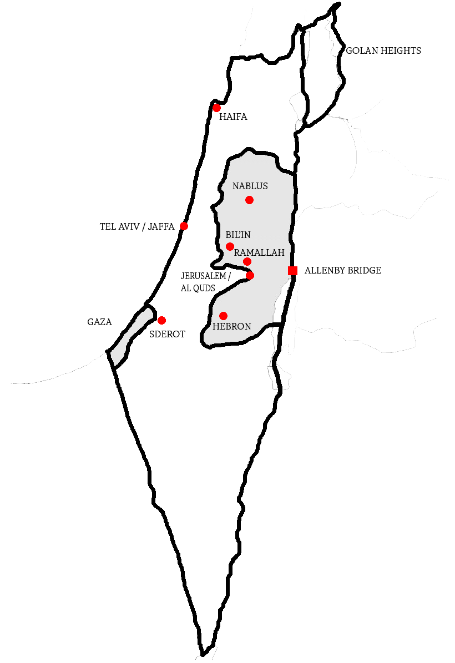
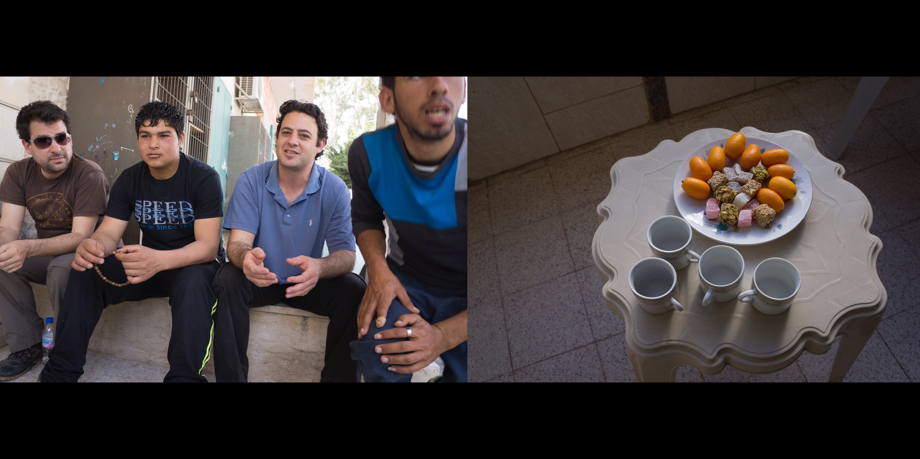

L: Jewish Israeli activists and Palestinians in Bil’in, West Bank
R: Kumquats in Ramallah, West Bank
Notes:
To better communicate with Palestinians, some Jewish Israeli activists learn Arabic. Both Semitic languages, Hebrew and Arabic have many similarities in structure and vocabulary.
Thousands of Mizrahi and Sephardic Jews from the Middle East who first emigrated to Israel spoke Arabic, but generations after have stopped speaking it.
Most Israelis who study Arabic in school do so to gain entry into Israel's elite intelligence units.

Slide 7
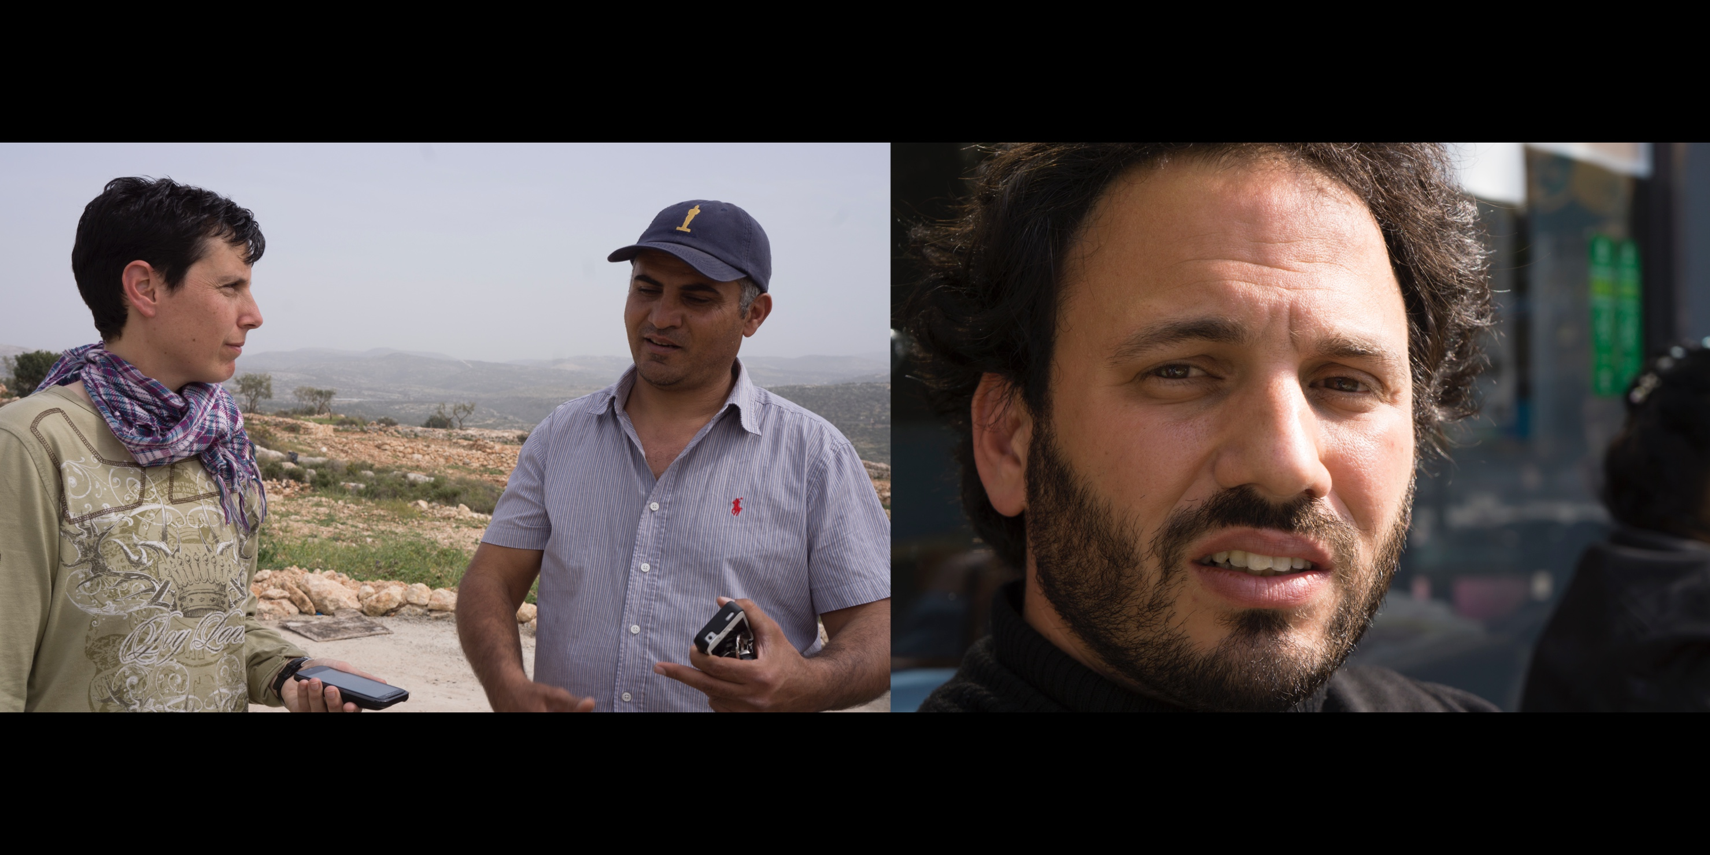
L: Interviewing Emad Burnat, Palestinian co-director of 5 BROKEN CAMERAS, Bil’in
R: Guy Davidi, Israeli co-director of 5 BROKEN CAMERAS, Tel Aviv
Notes:
Prior to traveling abroad, and shortly after 5 BROKEN CAMERAS and THE GATEKEEPERS were nominated for Academy Awards in the documentary category, I taught an Israeli film class at the Austin Jewish Community Center. The Austin Film Society hosted a screening of 5 BROKEN CAMERAS towards the end of the class. After six weeks of screenings and discussions about the history of Israeli film, my class of mostly older Jews took a field trip.
5 BROKEN CAMERAS is the story of Emad Burnat, a Palestinian man living in Bil’in who begins to document his life when his son, Gibreel, is born. Burnat records the ongoing protest against the Occupation and the illegal Jewish Israeli settlement on Bil’in’s agricultural land. The film is named after the five cameras that are violently broken as Burnat makes the film.
5 BROKEN CAMERAS is a rare glimpse of the West Bank from the perspective of a Palestinian, and my class found it hard to watch. To the film’s young Gibreel, protest and violence is his normal. He sees his father taken away in the middle of the night, settlers burn the village’s olive groves out of spite, the destruction of Burnat’s cameras by soldiers and settlers, and the instant, tragic death of a dear family friend who is hit in the chest by a tear gas canister. I do not think my class would have gone to see this film had it not been co-directed by an Israeli, and nominated for an Academy Award as an Israeli film.
In one particularly controversial part of the film, a Palestinian protestor is held by an Israeli soldier while another IDF soldier shoots him in the knee. This footage, and more, would go on to be used in court as evidence, and by news agencies, Internet videos, and other documentaries. Some students remained skeptical and defensive, citing how they saw Palestinian protestors throwing rocks. I had invited a friend, a former Israeli soldier, to visit the class. He served on patrol duty in Gaza during the first Intifadah and rarely talks about it. “Yes, they threw rocks at us,” he said, “and mostly we just laughed. Rocks compared to the kind of weaponry and armor we had, c’mon? Yes, we could get injured or killed by a rock, but that was nothing compared to the damage we could do to them.” He told the class he was often given orders to “show presence” and go into Palestinian homes and harass people day or night.
------------------
When I interviewed Burnat he had just come back from the Academy Awards ceremony. His entry to Los Angeles had been blocked until Michael Moore came to his aid. Comedian Seth MacFarlane hosted the ceremony and opened with the song and dance number, “Show Me Your Boobs.”
------------------
It is very unusual for a film to be co-directed by a Palestinian and an Israeli. When I asked Burnat about it, he said he worked with Guy because they had been friends for a long time. Guy was an Israeli activist at the weekly protests in Bil'in for many years before he and Burnat collaborated on a film.
------------------
Burnat has faced criticism from other Palestinians for breaking the boycott and accepting Israeli funds for the film, and because his wife appears on camera.
When I first got in touch with Burnat, I referred to the film as an Israeli film, which almost cost me the interview. “It is a Palestinian film,” he said. “It is about Palestinian lives. It was shot by a Palestinian. It is a Palestinian story. It is a Palestinian film.”

Slide 8
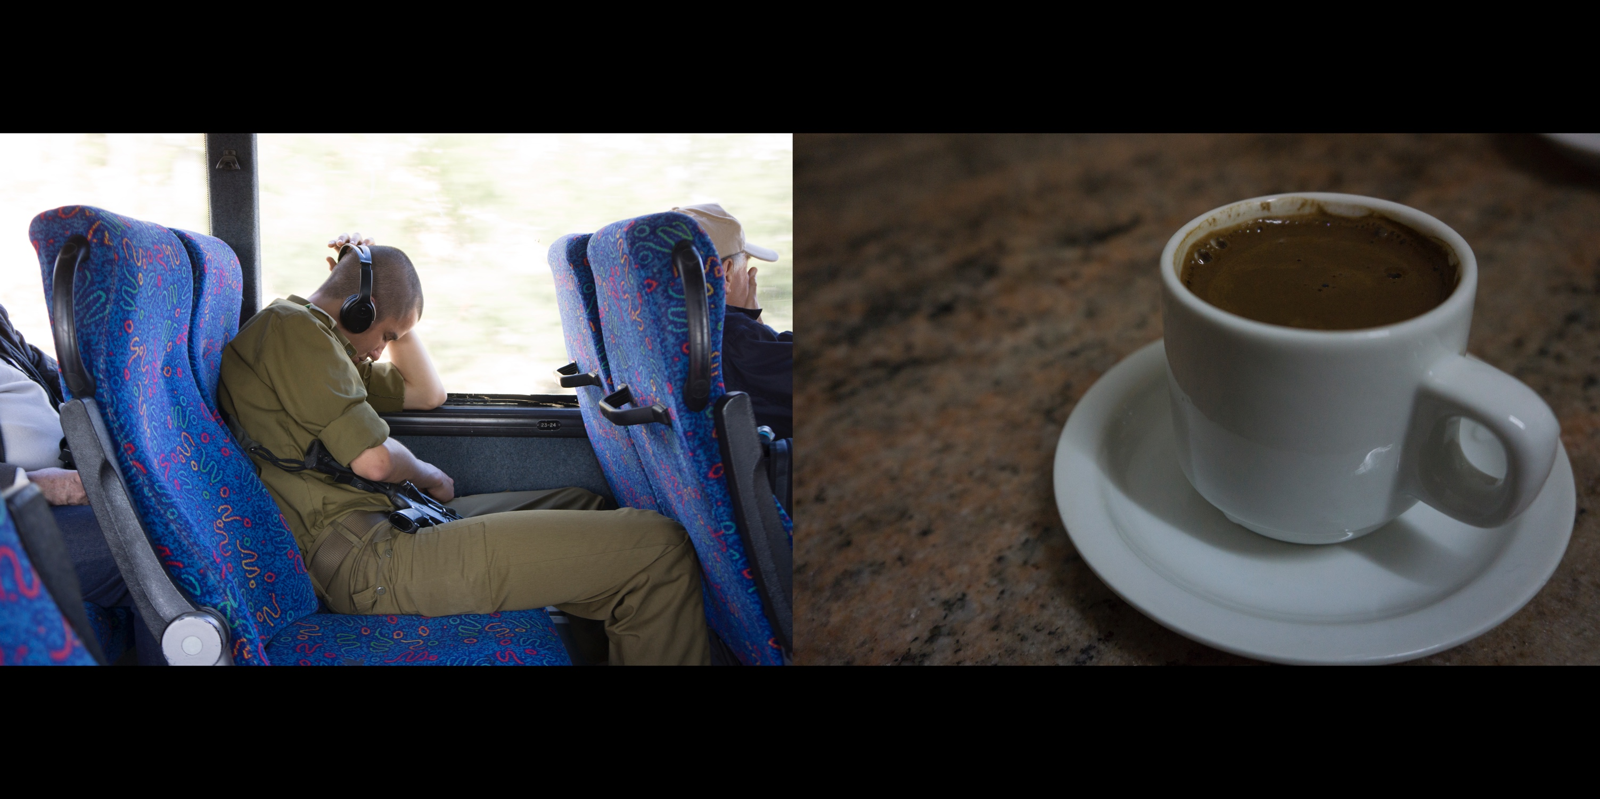
L: An Israeli soldier on a bus from Tel Aviv to Jerusalem
R: A cup of espresso inside the Muslim quarter of the Old City of Jerusalem
Notes:
At eighteen years of age, Israeli citizens are required to serve in the military. Men serve three years and women serve two. Israeli Arab citizens, Druze citizens, and Orthodox Jews whose profession is to study the Torah are exempt. Once issued a weapon, soldiers must carry it with them at all times.
Although they grow up living only 20 to 40 minutes from each other, most Jewish Israelis do not meet Palestinians living under occupation until they serve in the military. Likewise, those living under occupation only encounter with Israelis is with soldiers in the IDF.
“It’s like Brooklyn and Manhattan,” a friend told me. Jerusalem and Ramallah are that close to each
other.
––––––-
In 2017 the Israeli High Court ruled the exemption to military conscription for Orthodox Jews unconstitutional. In response, some extremist ultra-Orthodox Jews have taken to the streets, shutting down major roads and light-rail operations. To date, several hundred Israeli men have been arrested protesting their conscription.

Slide 9
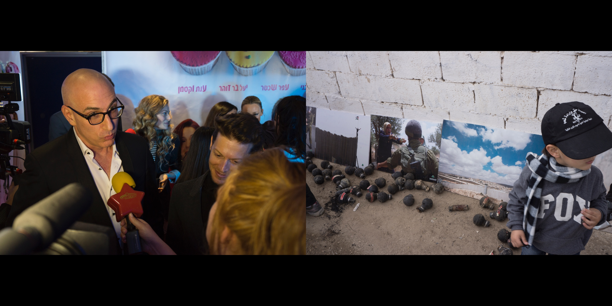
L: Eytan Fox at the premiere of his film, CUPCAKE, Tel Aviv
R: Photos of the weekly protest in Bil’in, along with empty tear gas canisters fired at protestors.
Notes:
Eytan Fox is Israel’s most commercially successful director. His best known film, WALK ON WATER, is a well-crafted narrative about a Mossad agent assigned to track down a Nazi war criminal, and is one of Israel's highest grossing films abroad. The premiere of CUPCAKE was filled with press and well- known actors. I enjoyed the free drinks and cheese fondue (not pictured).
Fox is also known for his groundbreaking projects that feature gays and lesbians. His 2002 success, YOSSI & JAGGER, tells the story of a relationship between two male soldiers in the IDF (Israel’s military). Fox’s TV series, FLORENTIN, centers around two gay male men who live in the south Tel Aviv neighborhood, Florentin, a working class, immigrant populated, cruising mecca similar to New York’s meat packing district (before gentrification in the 1980's and 90's).

Slide 10
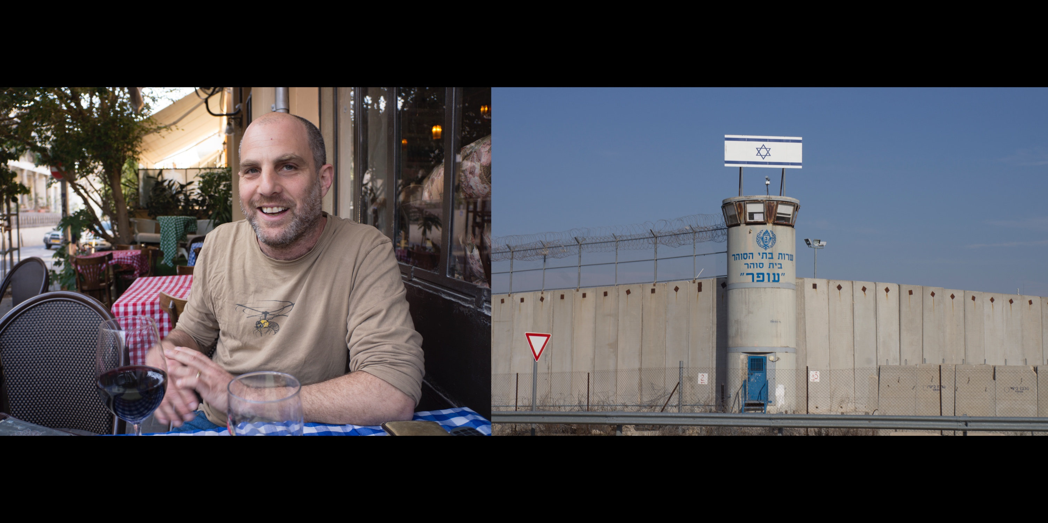
L: Israeli film director Eran Kolirin, Neve Tzedek (Tel Aviv)
R: Ofer prison, Occupied West Bank, near Qalandia Checkpoint
Notes:
If Eytan Fox is Israel’s Steven Spielberg, Eran Kolirin is Terrence Malick with his ephemeral approach, and Stanley Kubrick, with his colorful, witty, and satiric visuals. I spent an afternoon with Kolirin talking mostly about the relationship between music composition and the experience of film.
The director’s best known film, THE BAND’S VISIT, rivals Eytan Fox’s WALK ON WATER and Joseph Cedar’s FOOTNOTE as Israel’s highest grossing film. THE BAND’S VISIT was a festival hit, particularly at Jewish film festivals in the US. The film tells the story of what happens when a hapless Egyptian orchestral band comes to Israel for a concert at the Egyptian embassy in Tel Aviv and takes a wrong bus, ending up in a remote town in the Negev, Israel’s southern desert.
THE BAND’S VISIT is allegorical, and often misunderstood. People find hope and optimism in the film because of its likeable characters and funny moments, but Kolirin sees it as a fatalistic, pessimistic story about the inability to communicate and the lost chance to connect. It is an allegory of the tragic failure of separation. When characters do connect in the film it is for sex only, or within a context of shared consumerism. Two characters have a “date” under the lonely fluorescent lights of the town’s only fast food restaurant.
THE BAND’S VISIT was to be Israel’s official submission to the 2007 Academy Awards in the foreign language category, edging out Joseph Cedar’s film, BEAUFORT. However, those close to Cedar cited an Academy rule specifying that a film in that category must have no more than 50% of its dialogue spoken in English. Most of the dialogue between the Arabic speaking Egyptians and the Hebrew speaking Israelis in Kolirin’s film is in English because that is the common language between them. THE BAND’S VISIT was disqualified and BEAUFORT became the nomination. The German film, THE COUNTERFEITERS, took the award that year.
------------------
Ofer Prison had been cited for human rights violations and ill treatment of Palestinian prisoners numerous times by nongovernmental human rights organizations such as Amnesty International and the US State Department.
Ofer prison is privately run. G4S, the third-largest private corporation in the world after Wal-Mart and Foxconn, operated and maintained security systems at the prison until 2016 when they pulled out for "financial reasons."
G4S hires more people on the African continent than any other employer.

Slide 11
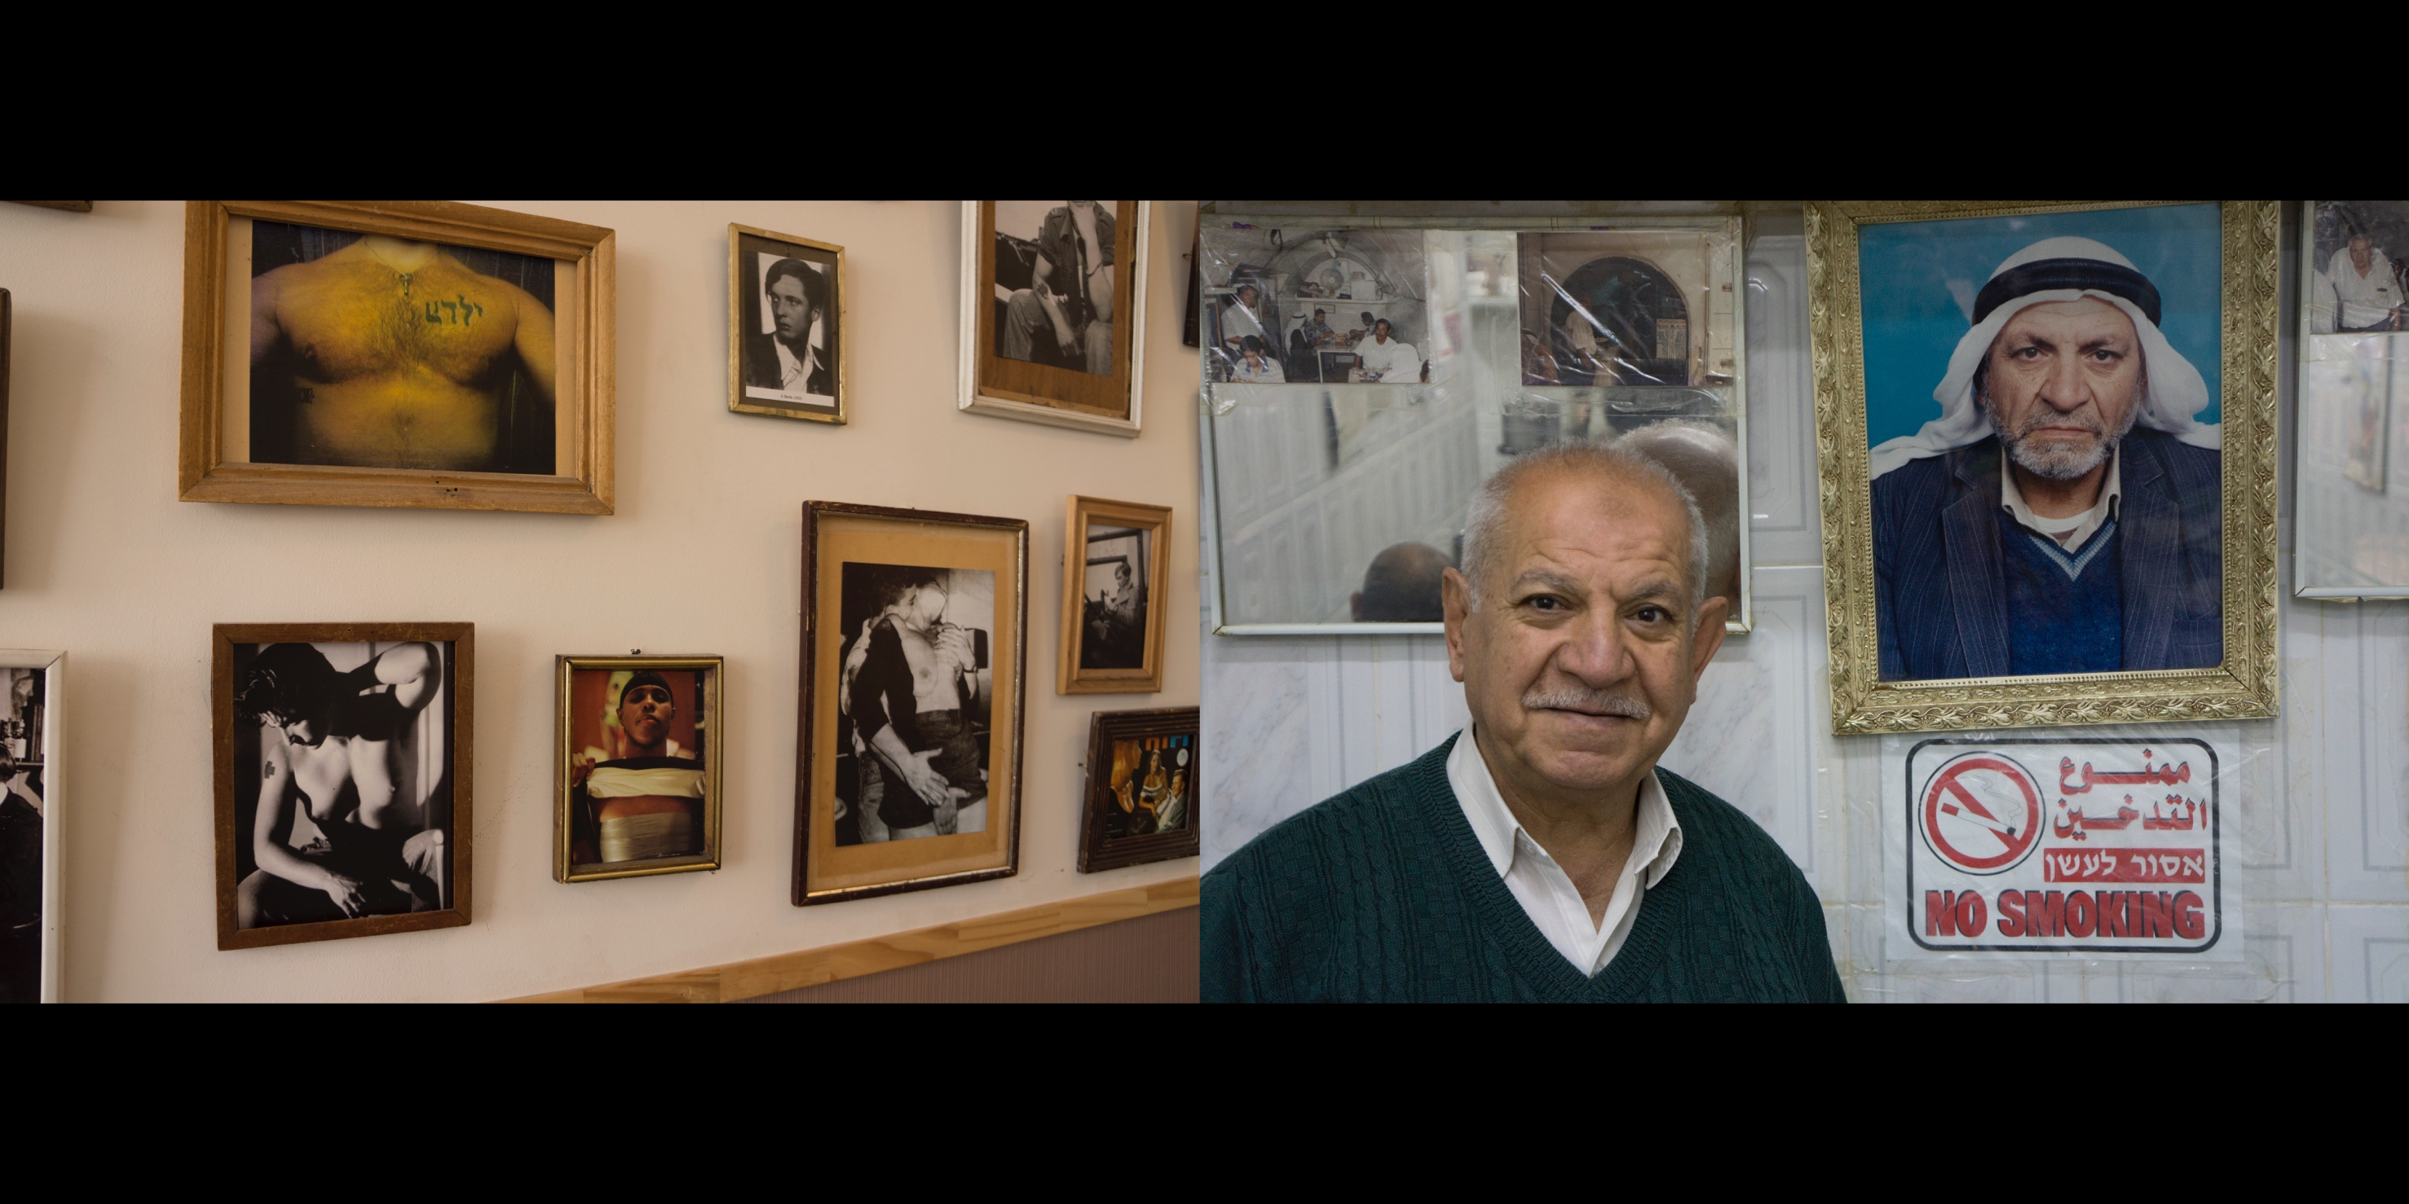
L: Café Albi, Florentin, Tel Aviv
R: The owner of Abu-Taher restaurant standing in front of a picture of his father,
Muslim Quarter, The Old City of Jerusalem
Notes:
Café Albi, a queer, vegan place in the industrial neighborhood of Florentin, felt immediately familiar, like walking into Austin’s Cheer Up Charlies when it was on East 6th street, or that secret, divey place on Airport only the queers knew about. Images of genderqueer films, icons, and art hung on the wall.
The male chest in the upper left hand corner of the frame has an interesting spelling of “yaldah,” the Hebrew word for girl. The last letter is turned upside down. If that letter were to be removed, the remaining word would be “yeled,” the Hebrew word for boy.
Albi is the kind of place where you can go outside onto the crumbling sidewalk with your beer and walk across the street to the corner store. I liked this part of Israel, the part that felt wild and unregulated, the part with cellphone shops with secret doors leading to rooms filled with tech geeks prepared to unlock your iPhone.
I met people at the Albi Purim party who helped me get to Bil’in. Someone gave me a number of a person to call who, once I mentioned the right name, would tell me where to meet in the morning to get a ride to the occupied West Bank.

Slide 12
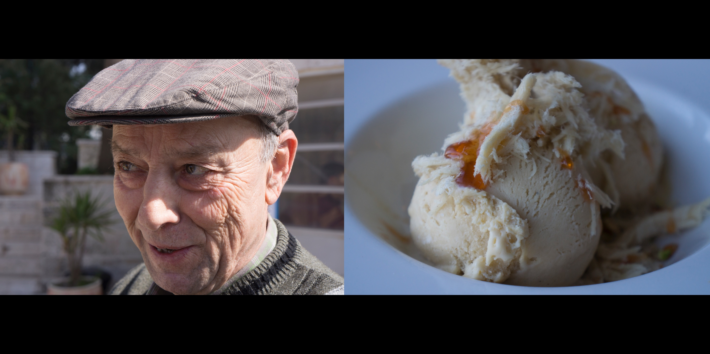
L: Palestinian filmmaker George Khleifi, outside his Qattan Foundation, Ramallah
R: Tahini ice cream at the Jerusalem Cinematheque
Notes:
Filmmakers and brothers George and Michel Khleifi made the well-known film, WEDDING IN GALLILEE, which received a critics prize at the 1987 Cannes film festival. The film takes place shortly after the war in 1948 in a Galilean Arab village ruled by an Israeli military governor.
In 1993, George Khleifi founded the Qattan Foundation to teach narrative filmmaking to Palestinians. Khleifi shows his students classic films from Hollywood to the French New Wave and is constantly raising money to buy the kind of camera and lighting equipment needed for scripted style productions.
I asked Khleifi if he supports the nonviolent movement to boycott, divest, and sanction Israel (BDS). He said he does not because saying “yes” gives him leverage. When he was invited to screen WEDDING IN GALILEE at the Jerusalem Cinematheque he said yes, provided the Cinematheque programmers locate the original Palestinian owners of the land on which the Cinematheque was built, and ask their permission.

Slide 13
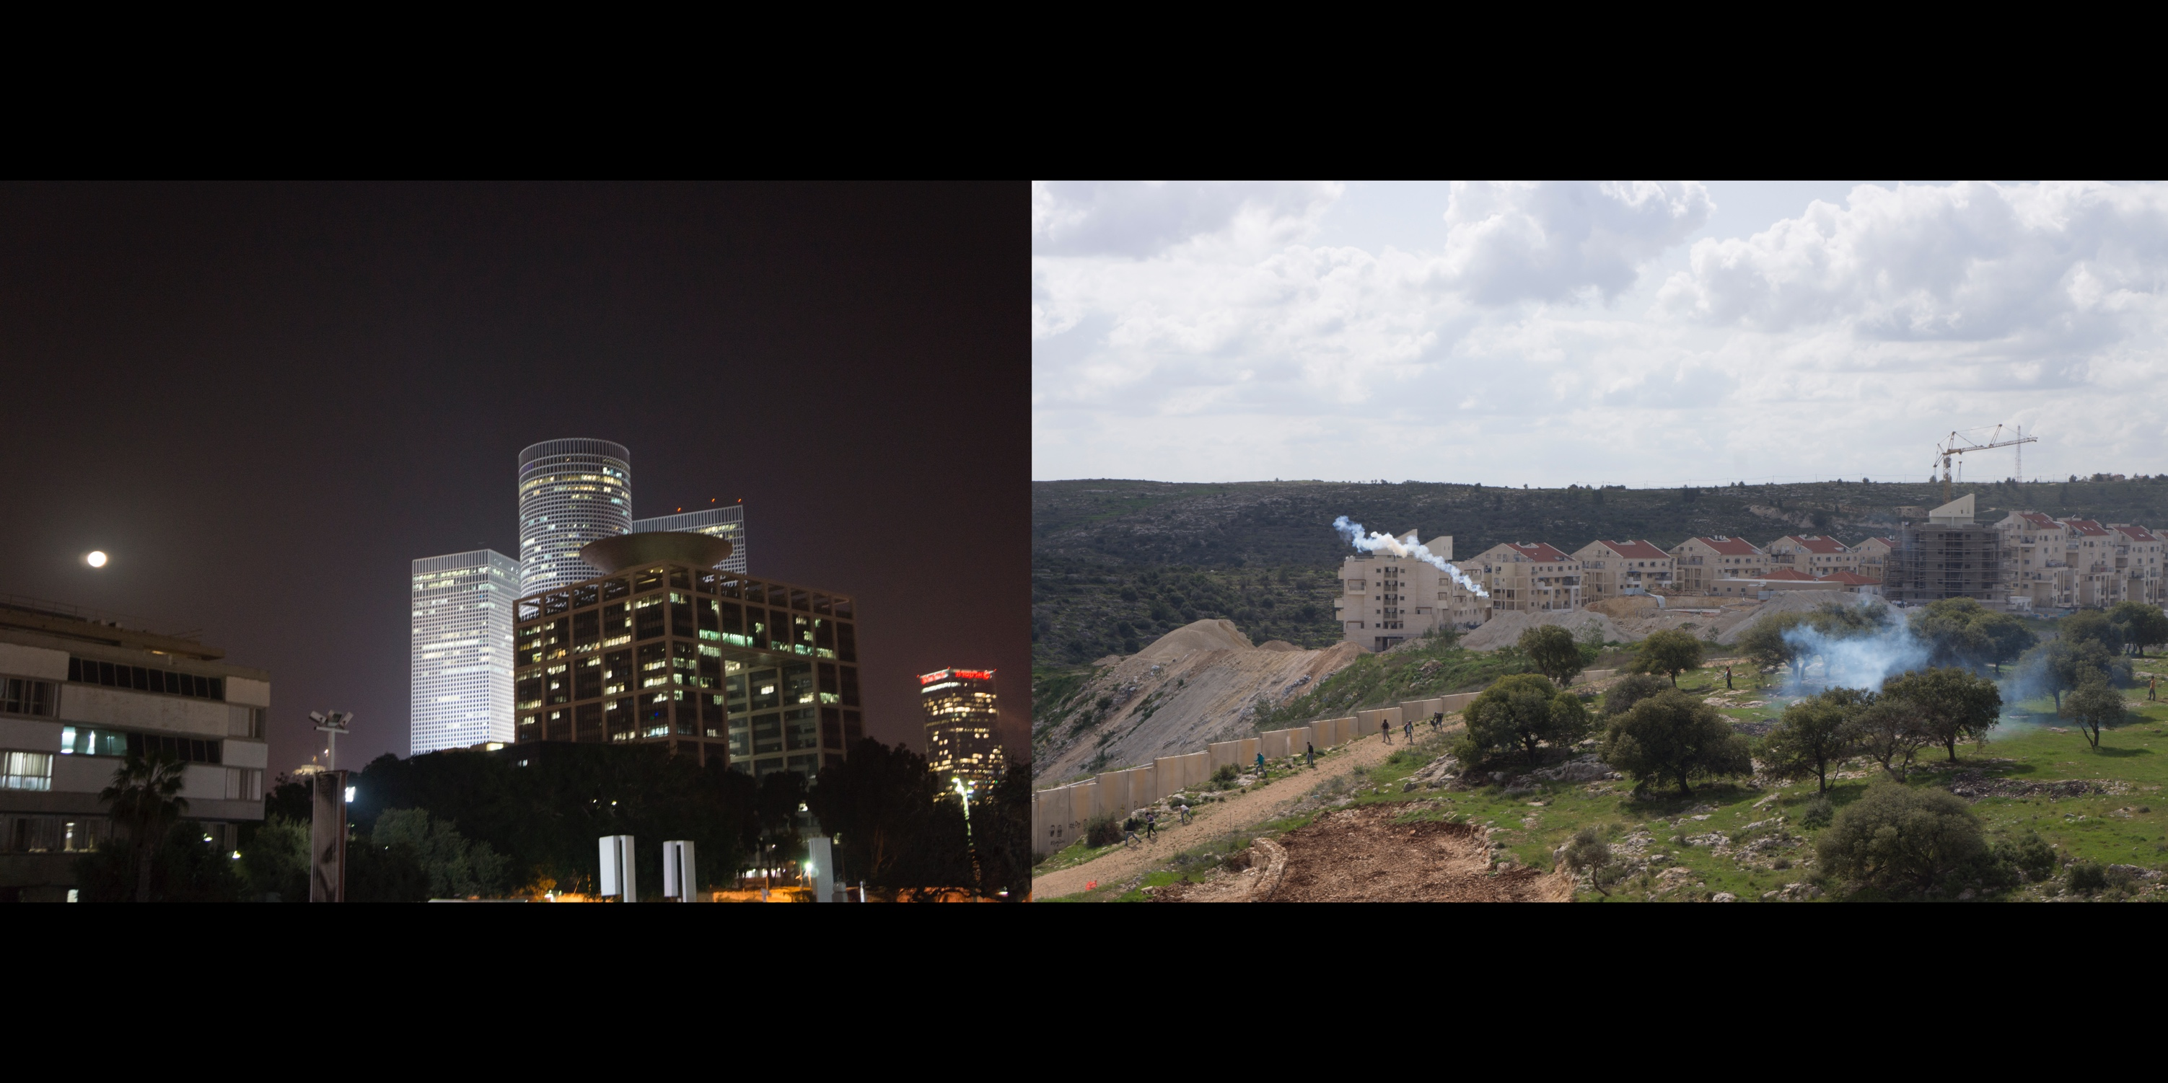
L: Tel Aviv skyline
R: Tear gas fired by the Israeli military (IDF) over a wall that separates and protects an
illegal Jewish Israeli settlement on Palestinian land in the West Bank (Bil’in)
Notes:
I first visited Bil’in on the eight-year anniversary of the weekly protest against the Occupation and the construction of illegal Jewish Israeli settlements. The Oscar nominated film, 5 BROKEN CAMERAS, chronicles these protests through the eyes of Bil’in filmmaker, Emad Burnat, who began shooting footage when his son, Gibreel, was born.
Frequent injuries, even deaths, occur at these protests. The film gets its name from the five cameras broken as Burnat shoots the documentary. Three cameras are destroyed by Israeli rubber bullets, a Jewish settler smashes another, and a fifth is lost when Burnat crashes his truck after crossing the barrier to work the land.
When I saw that the Prime Minister of the Palestinian Authority, Salam Fayyad, was in attendance that day, along with a swell of international press and other dignitaries, I felt confident that no tear gas would be fired. I was incorrect.

Slide 14
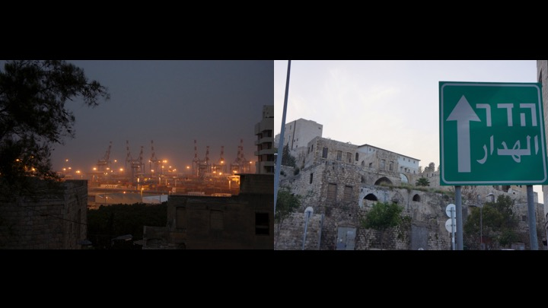
L: The port of Haifa
R: The ruins of Wadi Salib, an Arab village in Haifa bombed from above in 1948. The sign
points to how to get to Hadar, the neighborhood where Masada is located.
Notes:
I went to Haifa to see Masha, an activist I first met online. She knew most of the people I had been hanging out with in Tel Aviv. Israel is a small country, the size of New Jersey. Those who make up a smaller population within an already small population, such as the film industry or queer community, tend to know each other.
After drinks at an “everyone welcome” café, Masha took me on an activist walking tour which included the ruins of Wadi Salib. In 1948, 60,000 Arabs left this city when war broke out. Israel confiscated most of the buildings under the Absentee Property Law, a bizarre legal code originating under the Ottoman Empire. Thousands of Jewish immigrants from North Africa and the Middle East (known as Mizrahim) were later housed in Wadi Salib.
In the 1950’s, the residents of Wadi Salib were largely unemployed and the neighborhood suffered from poverty, neglect and crime. When a Mizrahi Jew was killed by Israeli police in July of 1959, years of discrimination and impoverished living gave way to full blown riots. Protestors threw rocks at the police and blocked roads on their way to Haifa’s wealthier Carmel neighborhood, where they torched cars and looted local shops. [source: Haaretz newspaper]
Masha left Russia as a child with her family in the 1980’s when thousands of Refuseniks were granted emigration to Israel. Housing is cheaper for Jewish Israelis across the Green Line, in the occupied West Bank, and many Russian immigrants live there. In recent years, Russian immigrants have been a dependable voting bloc for right wing candidates like Benjamin Netanyahu.
Masha, who is queer, has been an anti-Occupation activist since her late teens. The two go together. Queers don’t come to understand the arbitrary, power serving basis of sexual categorization and then think that other forms of social formation are just natural.
Masha is now living in Australia. Burnt out and feeling hopeless, she sucked it up and worked an IT job for the years it took to save the thousands of dollars needed to apply for a permanent visa out.
Masha’s black and white experimental photography has been exhibited internationally. Sometimes, she told me, curators ask if she can include pictures of the Occupation because, they explain, it makes it easier to get funding.

Slide 15
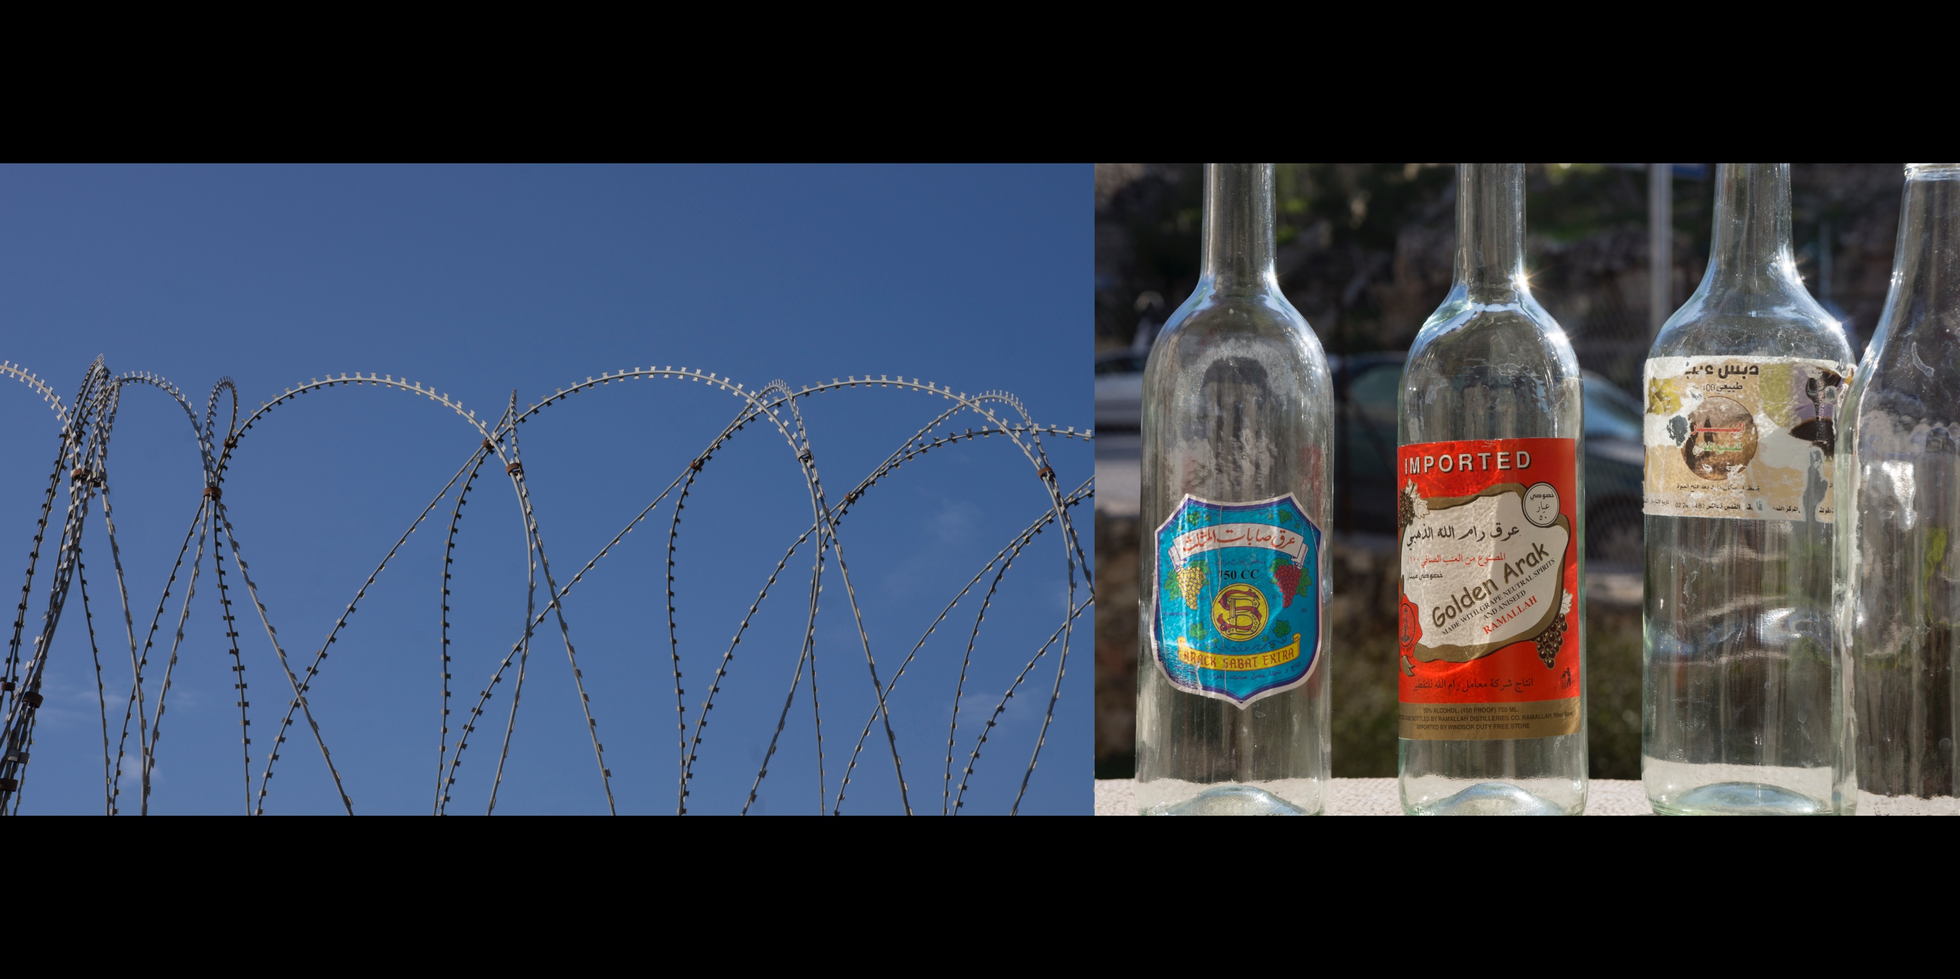
L: Israeli razor wire, banned in several countries, outside of Jerusalem
R: Bottles of Arak, an anise flavored alcoholic spirit, Ramallah
Notes:
One of the top 8 weapons and military technology exporters in the world, Israel earns billions of dollars selling F-16 fighter planes, missiles, launchers, surveillance and radar systems.
Not much of a drinker, I did enjoy an occasional shot of the licorice tasting beverage found across Israel/Palestine. A label on a bottle purchased in Ramallah looked like it had been placed by hand. “I don’t see a lot of manufacturing around here,” I mused. “As long as it’s alcoholic, should be OK as far as bacteria goes…?”
––––––
Israeli checkpoints, roadblocks, and other physical barriers in the West Bank form a comprehensive enclosure termed the “Iron Ring.” Following 9/11, the NYPD installed a network of more than 8,000 cameras to provide 24-hour blanket surveillance over the city, known as the “Ring of Steel.”

Slide 16
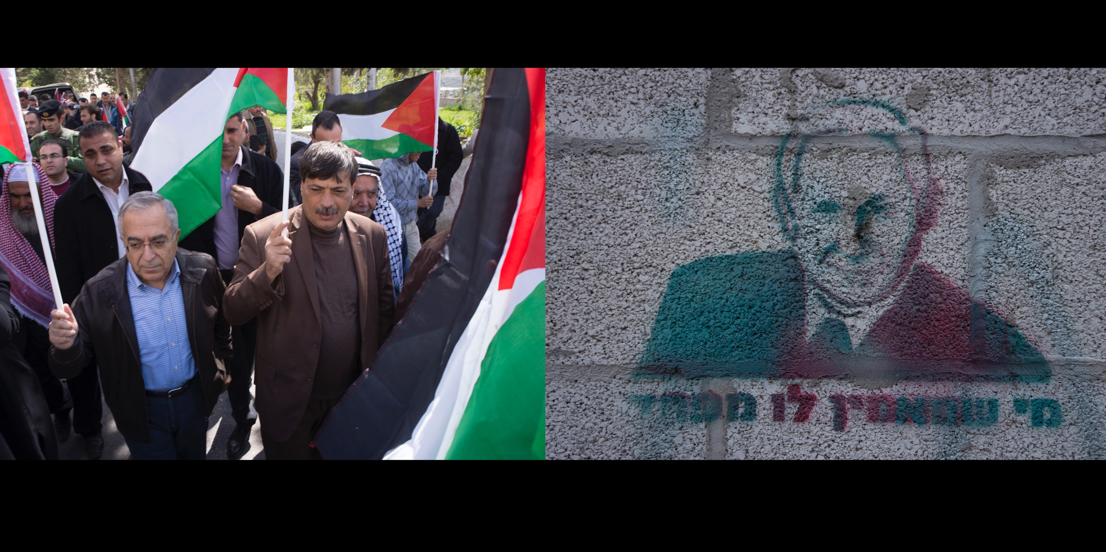
L: Salam Fayyad, Prime Minister of the Palestinian Authority from 2007-2013, Bil’in
R: Graffiti image of Benjamin Netanyahu, Prime Minister of Israel from
1996-1999, 2009-present, Haifa
Notes:
Looking for 5 BROKEN CAMERAS director Emad Burnat in Bil’in, I felt a crush of people and press around me. I was suddenly two feet away from Salam Fayyad, the Prime Minister of the Palestinian Authority.
Like his Israeli counterpart, Prime Minister Benjamin Netanyahu, Fayyad was educated in the West. He earned a PhD in economics from the University of Texas at Austin, and an MBA from St. Edwards University. Netanyahu received multiple degrees from MIT.
Before his political career with the Palestinian Authority, Fayyad was an economist for the International Monetary Fund and the World Bank. Prior to Netanyahu’s political life in Israel, he was an economic consultant for the Boston Consulting Group where he formed a lasting friendship with his colleague, Mitt Romney.
As Minister of Finance, Fayyad clashed with PLO Chairman and Palestinian Authority President Yasser Arafat. While in office, Fayyad conducted an audit that revealed how Arafat had diverted $900 million in public funds to bank accounts under his control.
------------------
There is a popular song in Israel, often heard on the radio, at weddings, and at right wing rallies, with the lyrics, “Those who believe in him [god] are not afraid.” By changing one letter, the graffiti in the photo reads “One who believes in him [Netanyahu] is afraid.”

Slide 17
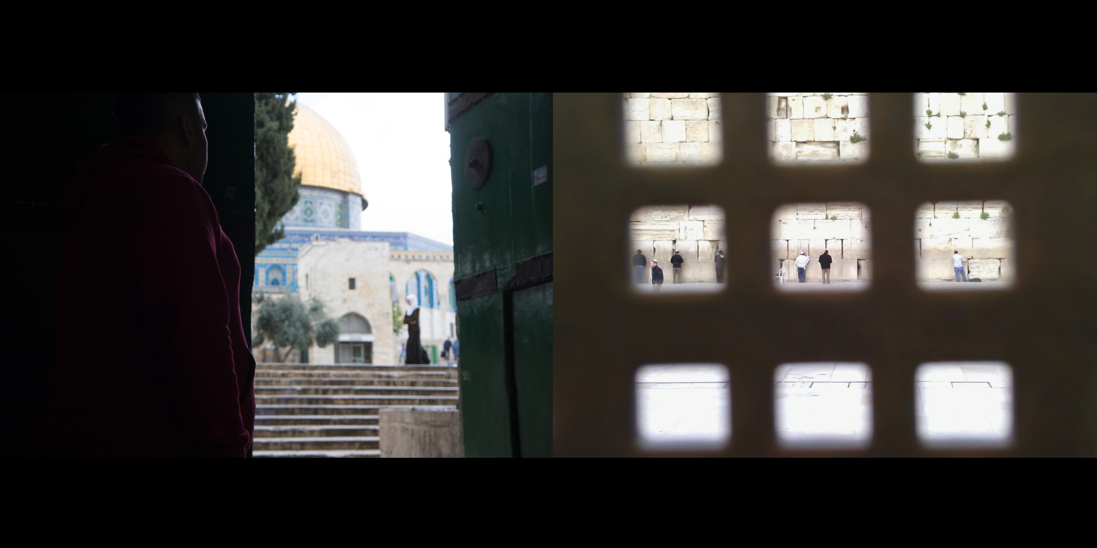
L: The al-Aqsa Mosque, Muslim Quarter, Old City of Jerusalem
R: The Western Wall, Jewish Quarter, Old City of Jerusalem
Notes:
The al-Aqsa mosque is the third holiest site in Islam. The compound on which it sits is also holy to Jews and is known as the site of the Temple Mount. The area is restricted to Muslims. I got as close as I possibly could. The moment after I took this picture I was asked to move back.
________
This part of the Western Wall, a Jewish holy site, is restricted to men only.

Slide 18
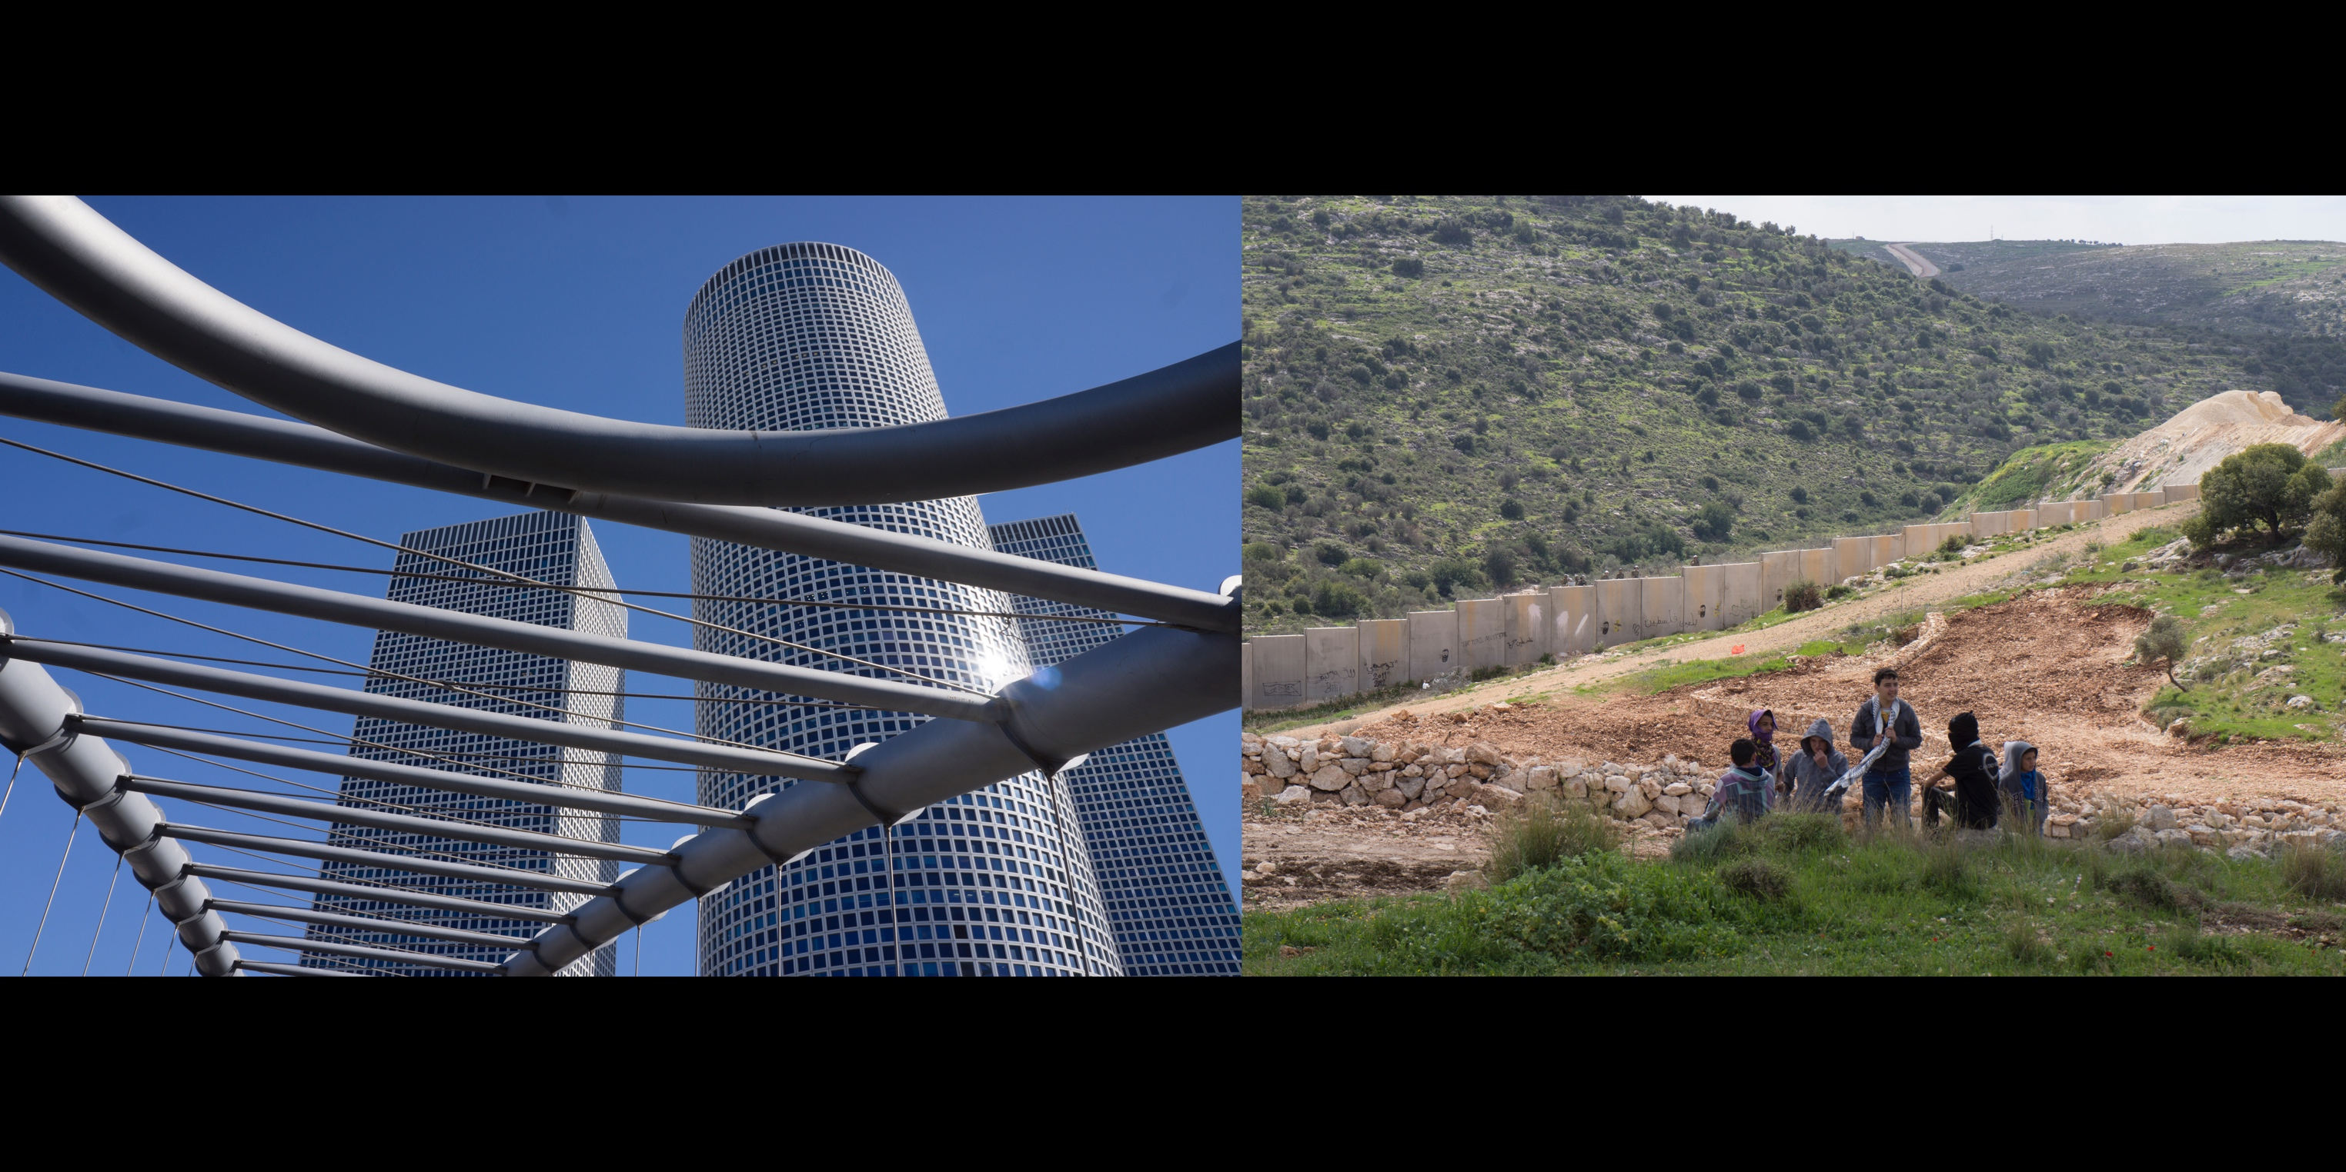
L: Azrieli building, Tel Aviv
R: Palestinian kids standing near a wall that separates and protects an illegal Jewish
Israeli settlement on Palestinian land in the West Bank, Bil'in
Notes:
While it is against international law for Israel to construct settlements in the West Bank, which the country has occupied since the Six-Day War of 1967, there is de facto, if not outright, support for the settlements. Jewish settlers seize occupied land, often under the cover of night, and lay claim to it by living in cargo containers and temporary shacks. Once rudimentary housing for Israeli citizens exists, the military moves in to defend those citizens, enabling settlers to construct permanent housing.
I became aware of this reality watching Jewish Israeli filmmaker Ra’anan Alexandrowicz’s award winning film, THE LAW IN THESE PARTS, at the San Francisco Jewish Film Festival. Through a series of highly stylized, reflexive interviews with those who wrote the complex system of military law that governs the occupied territories, the documentary asks “Can a modern democracy impose a prolonged military occupation on another people while retaining its core democratic values?”
Two groups of people live in the occupied territories, side by side, under different laws. The settlers are Israeli citizens who have rights to due process in a civilian legal system while the stateless Palestinians are not under that protection and are subject to military rule and jurisdiction. In the film, Alexandrowicz calls this apartheid.
------------------
When I met the director in Jerusalem the interview did not go well. My time abroad was nearing an end and I was worn out from traveling, tracking people down, passing through checkpoints, and maneuvering into different places. He had canceled on me a few times and I was feeling frustrated. I became sensitive to privilege and the way Israeli men refuse to share space, even a sidewalk. Alexandrowicz became a stand-in for all Israeli men. Even though he directed JAMES' JOURNEY TO JERUSALEM, a sly critique of materialist, exploitative Israeli society, and THE LAW IN THESE PARTS, which opened my eyes to the injustice and cruelty of the settler movement, I was not in the mood to give an inch to anyone. I had always asked permission to record interviews, but I felt no obligation to ask him. When he saw my phone on the table recording our conversation, he was rightfully put off.

Slide 19
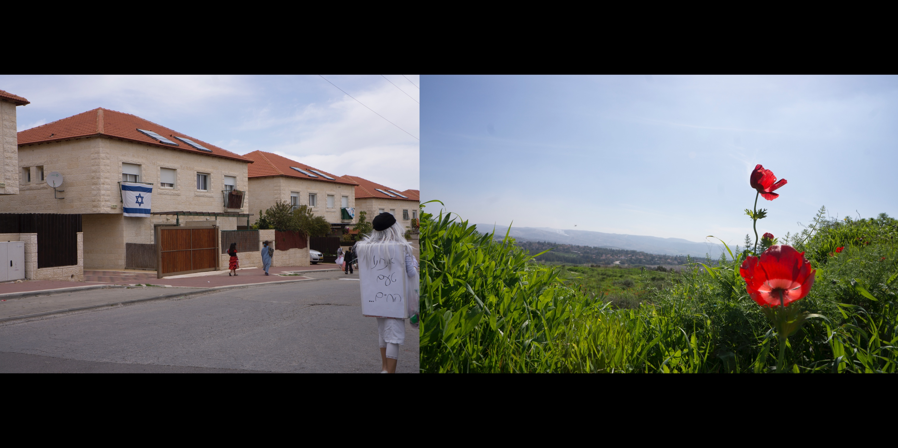
L: Inside an illegal Jewish settlement just east of Jerusalem on the Jewish holiday of Purim.
The writing on the costume references a popular Coca-Cola ad campaign, “The Taste of Life.”
R: A flower blooms on land that was once an Arab village inside Israel’s 1948 borders
Notes:
Purim celebrates the bravery of Queen Esther who hides who she is until she must, to save her people, reveal herself to be Jew. A popular holiday with kids, the tradition is to dress up in a costume and recount the Purim story. Whenever the story’s villain, Haman, is named, revelers make lots of noise so as to stomp him out, like he wanted to do to the Jews.
In Tel Aviv, Purim is celebrated like Mardi Gras with a big parade and lots of debauchery. I got a ride back from Jerusalem with a rowdy group of young people dressed up like rockabillies and nurses. I went to a late night party at the queer café, Café Albi, and noticed an Israeli guy dressed up like an Orthodox Jew. It reminded me of the girl I saw in the settlement dressed up like Santa Claus.

Slide 20
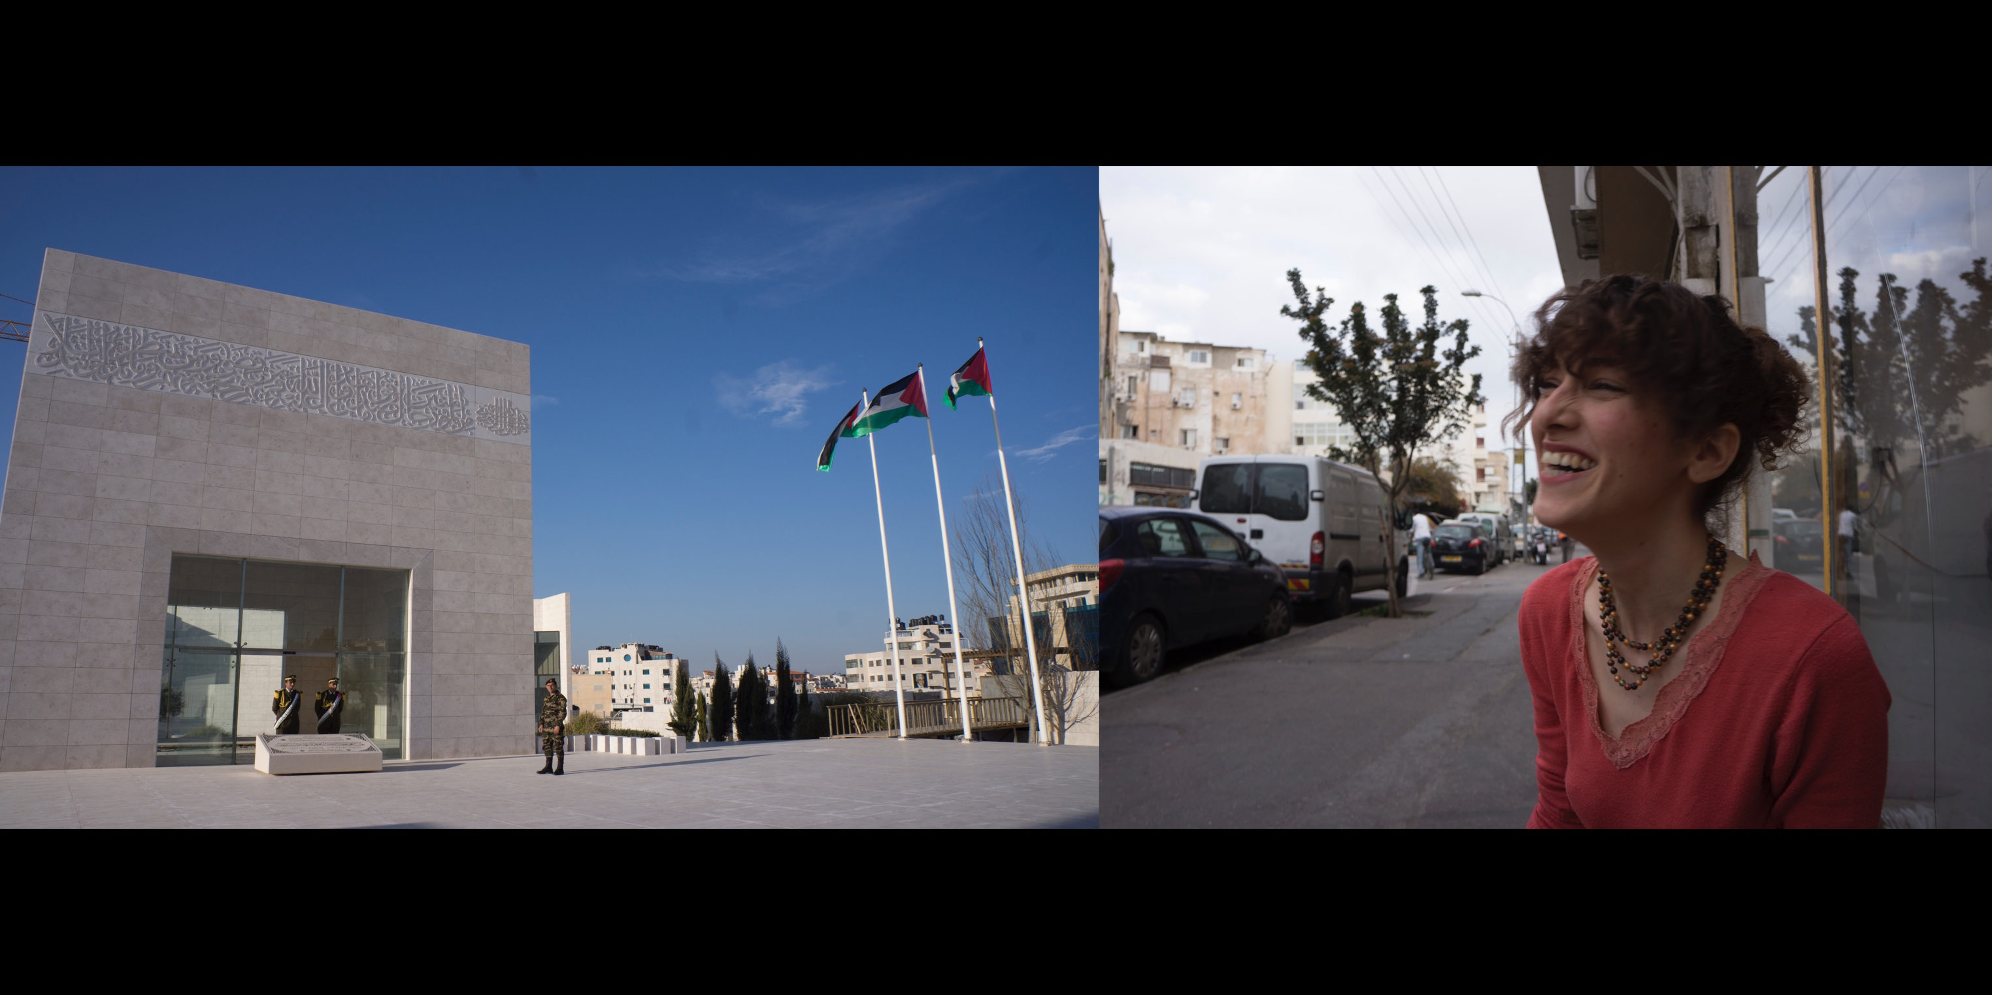
L: Yasser Arafat’s grave, Ramallah
R: Tali Shapira, a Jewish Israeli activist, outside Café Albi, Tel Aviv
Notes:
Walking the streets of Ramallah, I came across an impressive structure made of glass and light grey stone. I approached the building thinking it must be an important library or museum.
When I walked onto the plaza the guards stopped chatting, took their positions, and stood at attention.
I asked where I was.
Growing up in my US suburban Jewish home, this is not a place I believed I would ever visit.
------------------
Yasser Arafat was the Chairman of the Palestine Liberation Organization (PLO) from 1969 – 2004. His gravesite, in the heart Ramallah, is estimated to have cost 1.75 million dollars. Visitors are allowed to take a picture from only one perspective.
------------------
Tali Shapira is a Jewish Israeli activist who supports BDS, an international campaign to boycott, divest, and sanction Israel in protest of the Occupation and in support of full equality for Arab-Palestinian citizens of Israel, and the right of return for Palestinian refugees. Shapira is active on social media calling for artists like Beyoncé to show solidarity with Palestinians and refuse to play Israel.
It is a Civil Wrong in Israel, punishable by heavy fines, for citizens to call for boycotts against the government and against companies whose work with the government supports the Occupation. 26 states in the US have passed laws that prohibit state institutions from contracting with any business that supports BDS because, lawmakers claim, boycotting Israel in protest of the Occupation is antisemitic. Recently, Bahia Amawi, a school speech psychologist in Plugerville, Texas was fired for refusing to sign a commitment to not boycott Israel. The US Congress is debating legislation that will impose criminal and civil penalties on American firms that participate in boycotts in support of Palestinian rights. Amawi is suing the school district. Most legal experts in the US believe anti-BDS laws will be struck down because they infringe upon First Amendment rights of freedom of expression. It will likely go to the Supreme Court.
In a rare moment, in between drags of her cigarette, I caught Tali smiling.

Slide 21
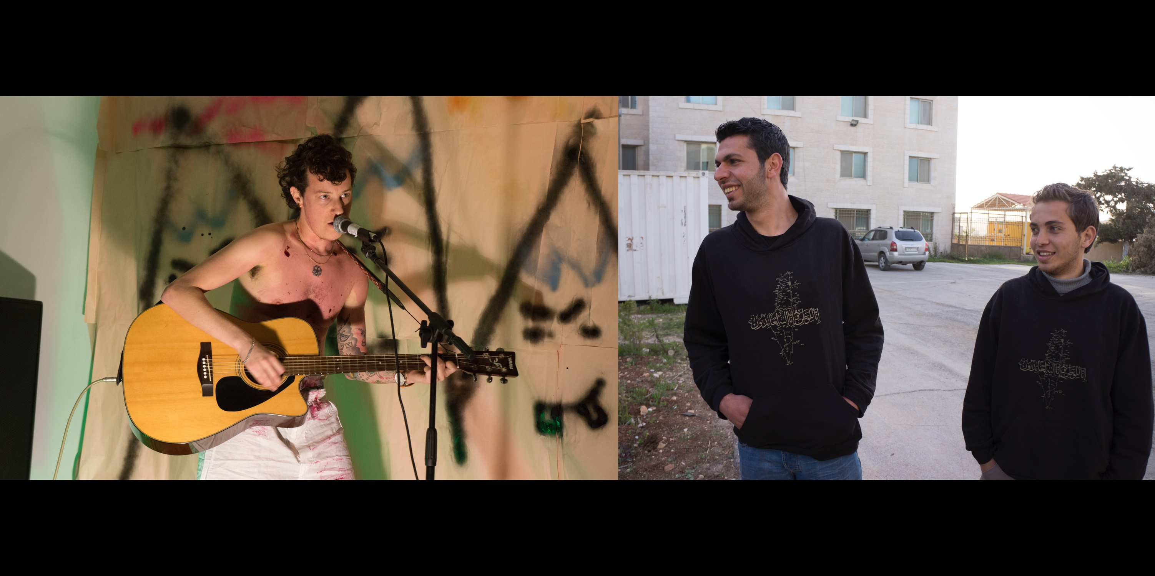
L: A performance in Florentin, Tel Aviv
R: Two students at Al Quds University wearing sweatshirts that support the Palestinian
right of return, Ramallah
Notes:
I met Oree Holban in Tel Aviv and we became fast friends. He is an Israeli transgender performance and visual artist, now living in Los Angeles.
In the Hebrew language, verbs and nouns are gendered, as are the pronouns “you,” “we,” and “them.” It is impossible to describe someone without naming their gender. Every time someone says “you,” they name your gender.
When I asked Oree what it’s like to go from speaking Hebrew to English he said it’s liberating.
------------------
The emphasis on learning film and media production at Al Quds, like everywhere in the West Bank, is on documentary and news style production. Entertainment oriented, scripted productions are rare. The Palestinian version of “Sesame Street” was a rare exception. Shot and produced at the modest facilities at the Al Quds Media Program and overseen by Sesame Workshop executives in New York, the show featured the main characters Haneen, a red-headed orange puppet, and the green rooster Kareem, who preached themes of tolerance and neighborly love. Known in Arabic as “Shara'a Simsim,” the show ran from 1996 to 2012 and employed many Al Quds students. In 2012 after Palestine appealed to the United Nations for State membership, the US Congress cut major funding for the program, and production stopped.

Slide 22
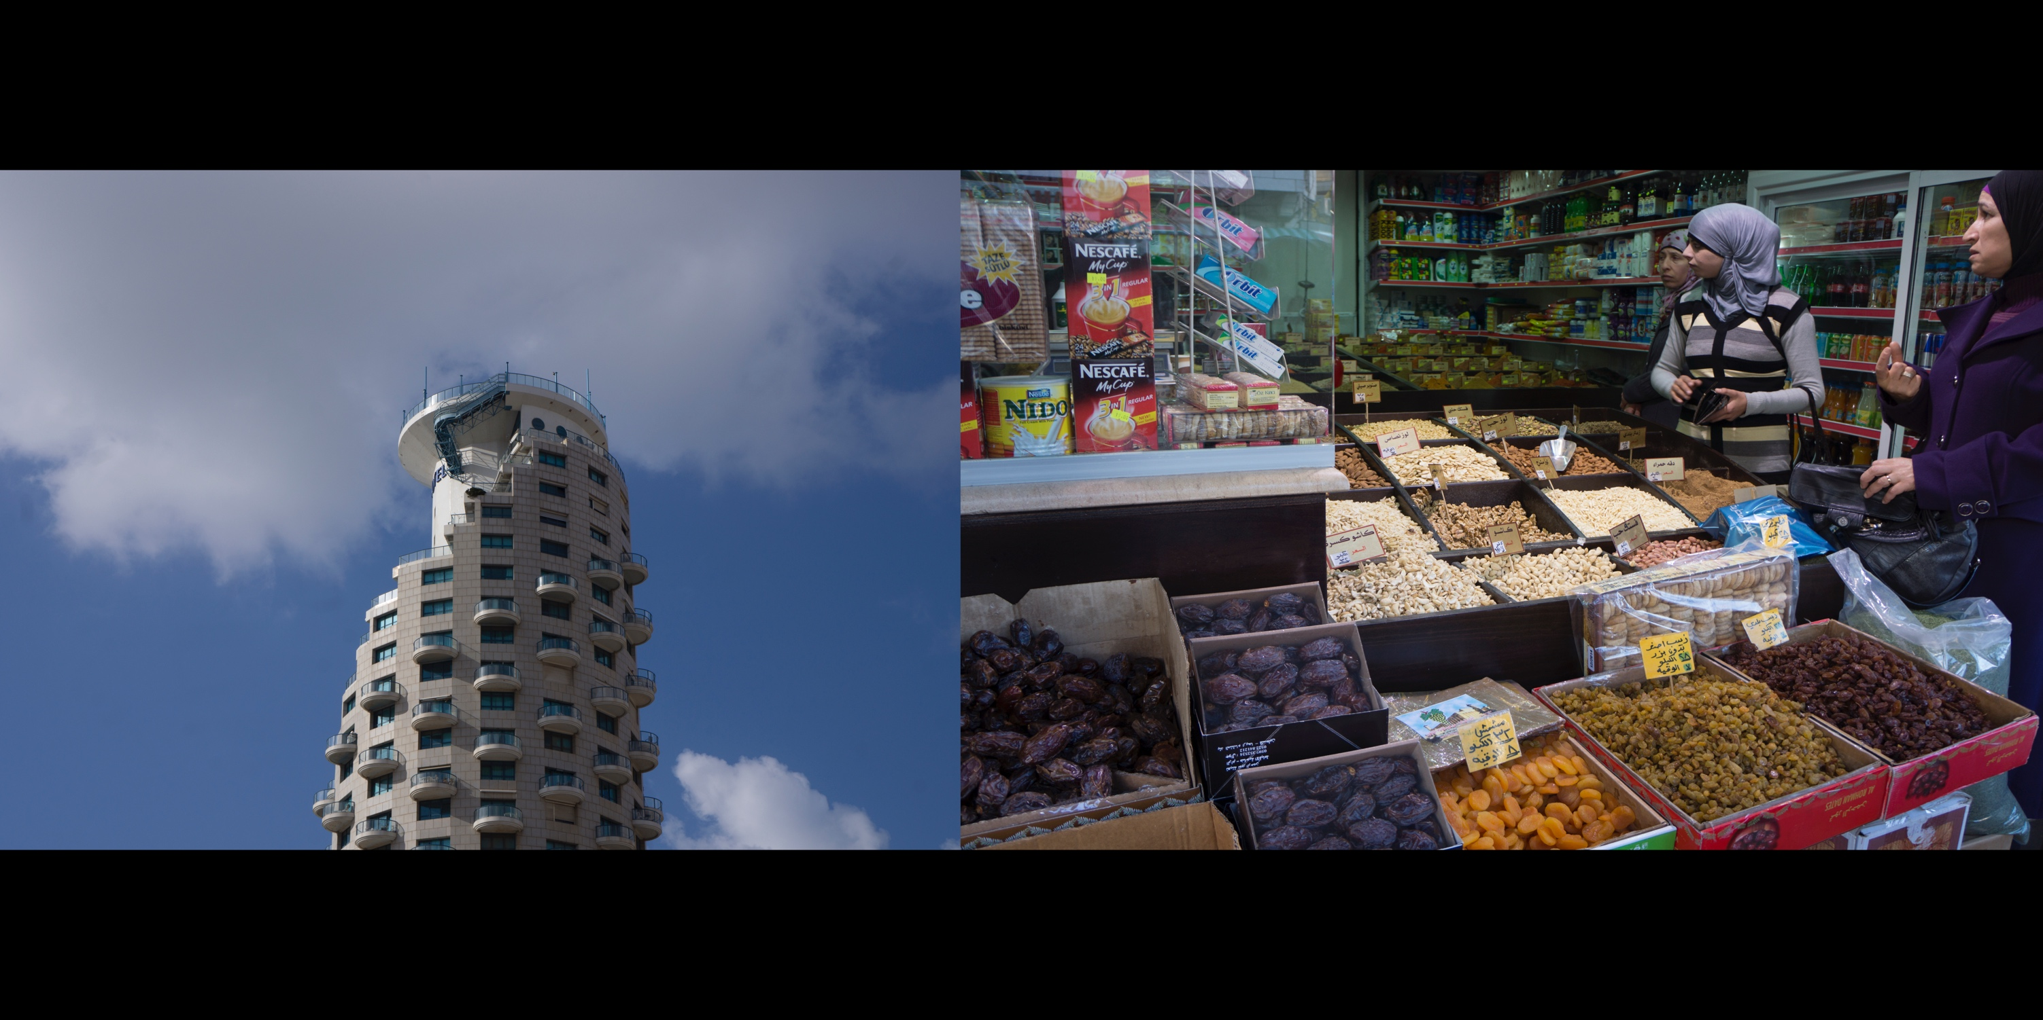
L: Isrotel Tower, a hotel in Tel Aviv
R: Spice store, Ramallah
Notes:
There is a common perception that Palestinian women have very few rights, and that women and members of the GLBTQ communities would be much better off in Westernized places like Israel than in the rest of the Arab world. There is also a common perception, a social amnesia, about what it’s been like for women and queers in the Western world for most of history. Like in the US, the more developed, politically representative, and economically stable places I visited in Palestine, the more equality and social inclusion I witnessed.

Slide 23
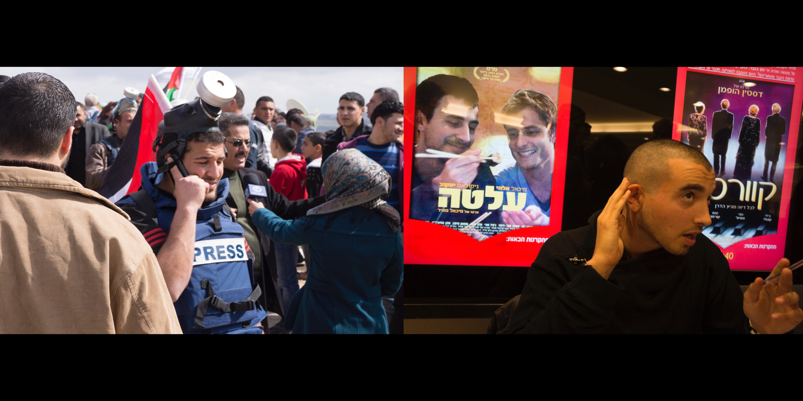
L: International press in Bil’in, West Bank
R: At the premiere of the film OUT IN THE DARK, Tel Aviv
Notes:
“I’m on the list,” I tell the guy at the Israeli premiere of OUT IN THE DARK, a film about a romantic relationship between two men, a wealthy Israeli man and a Palestinian student.
“Mike said to let me in.”

Slide 24
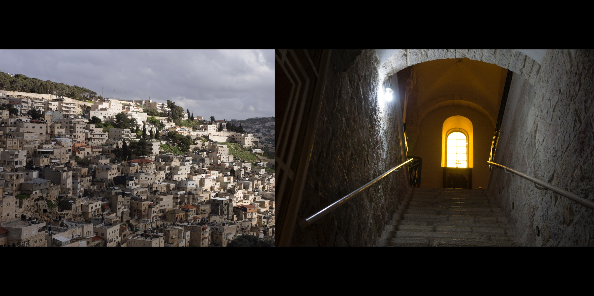
L: View of Silwan, a West Bank Palestinian village in east Jerusalem, as seen from the
walls of the Old City
R: Christian Quarter, Old City of Jerusalem
Notes:
Silwan is a predominantly Palestinian neighborhood in occupied East Jerusalem close to the al-Aqsa Mosque and near the walls of the Old City. The city has been under siege by Jewish settlers whose mission is to claim all of Jerusalem for Jews.
Elad, a private organization of Israeli Jews with the explicit goal of removing Palestinians from East Jerusalem and settling Jews in their place, controls Silwan’s City of David excavation site, where they believe the 3,000-year-old palace of King David once stood.
Despite archaeologists moving away from the practice of digging tunnels since the latter part of the 20th century, tunnels continue to be built at the excavation site that go precariously close to the ground under the al-Aqsa Mosque, and underneath the homes and property of Silwan residents.
Although a popular tourist site, no physical evidence shows that King David ever used the buildings despite the site being one of the most studied in Israel. Little more can be deduced than that the remains date to the Canaanite period 3,000 years ago.

Slide 25
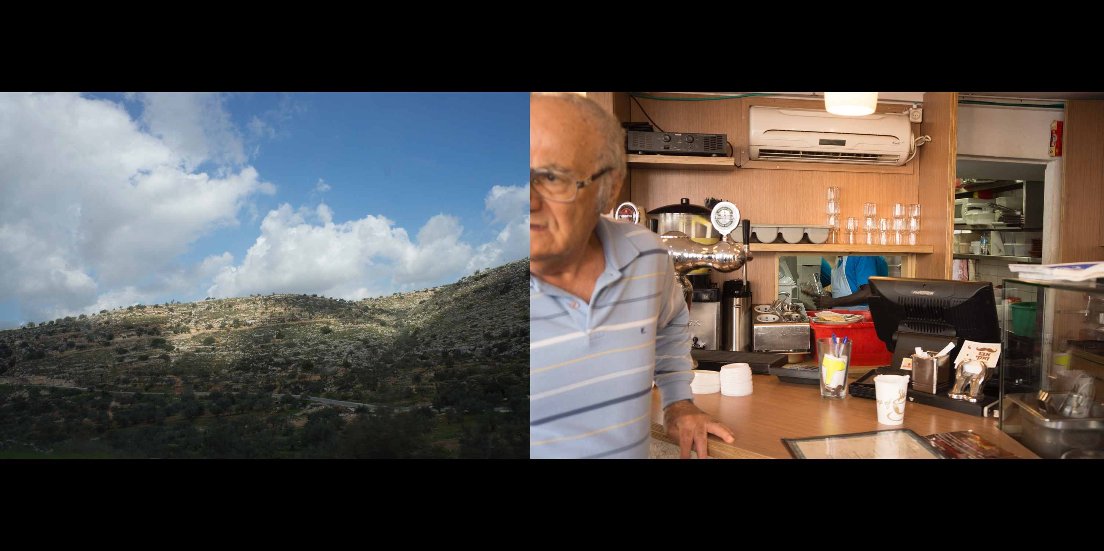
L: Somewhere on the way to somewhere, I don’t remember
R: Inside a restaurant on King George street in Tel Aviv
Notes:
Racism and discrimination within Israel’s Jewish population by Ashkeniazi Jews of European descent against Jews from the Middle East or North Africa (also known as Sephardic or Mizrahim) has existed since the beginning of the Jewish State. Jews who came to Israel from non-European nations were subject to being housed in detention centers, and institutionalized discriminatory practices in education and jobs. When an influx of Ethiopian Jews to Israel swelled in the 1980’s, these practices continued despite more awareness and concern within Israel’s population.
Recently, refugees from Eritrea and Somalia and other countries in the Horn of Africa have made their way into Israel along the southern border. Fleeing brutal dictatorship and what the United Nations calls “crimes against humanity,” most of the Africans who make it end up in Holot, an “open policy” detention center in Israel’s Negev desert. The center’s thousands of residents are allowed to leave during the day but are arrested and deported if they do not return at night. The nearest city is an hour’s bus ride away and refugees are forbidden to work.
One of the leading arms exporters in the world, Israel earns billions of dollars selling weapons to African nations such as Rwanda and South Sudan.

Slide 26
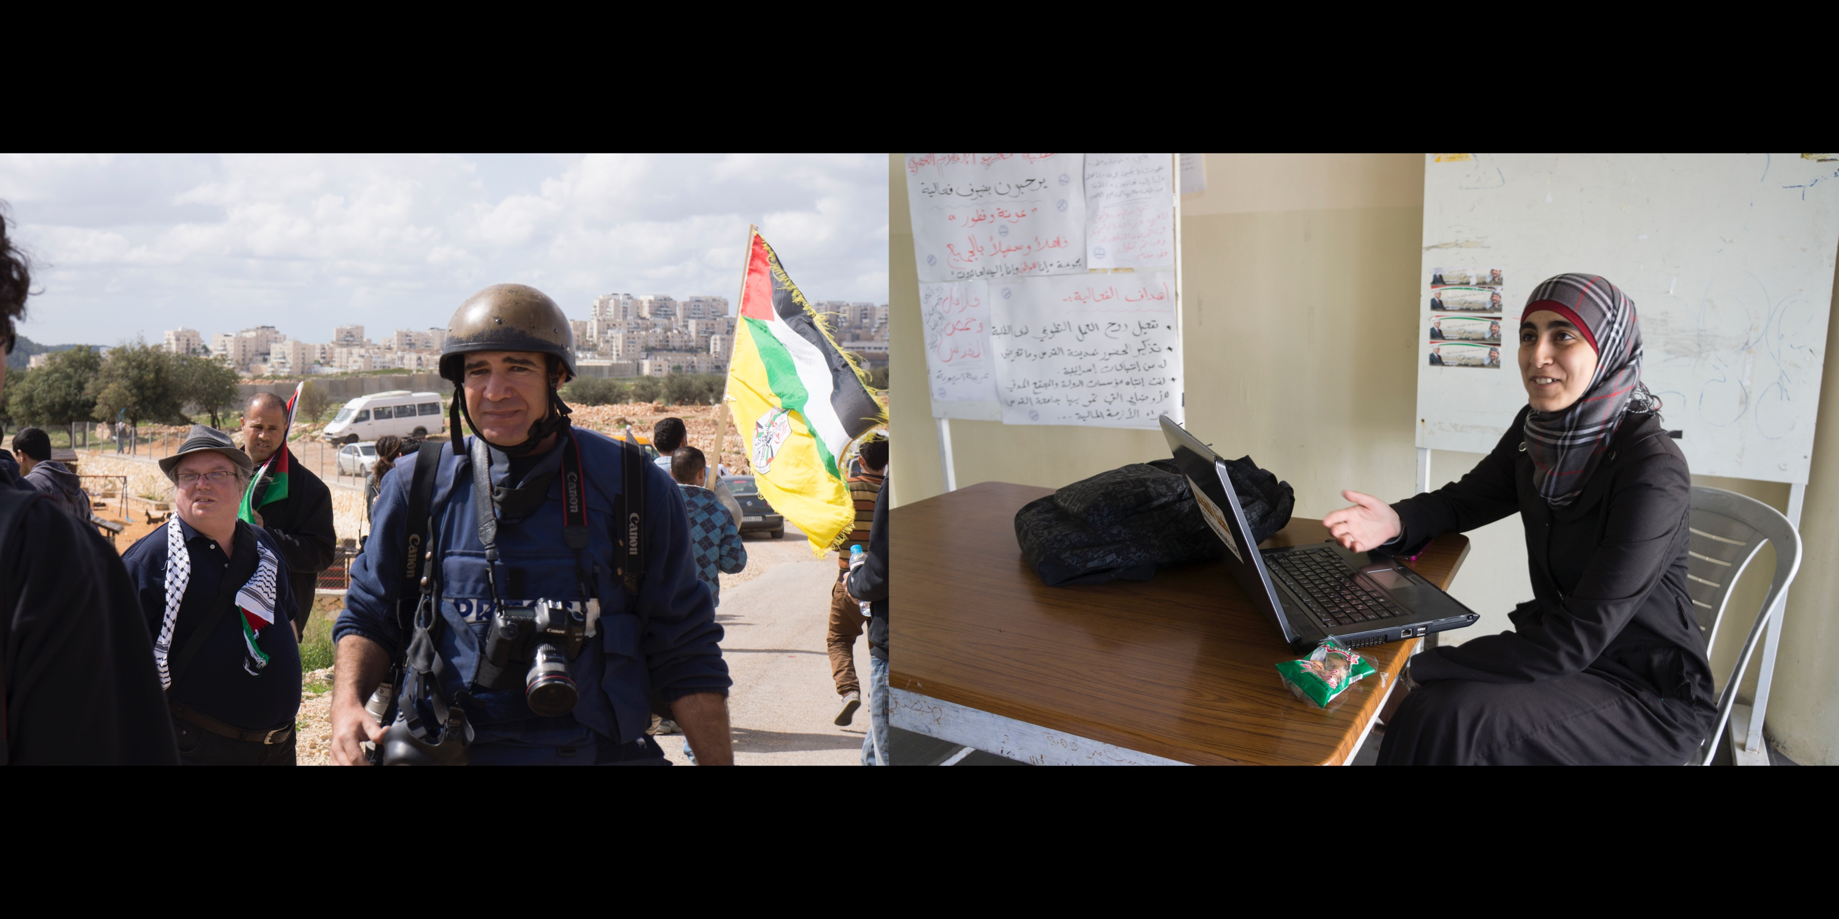
L: International Press in Bil’in, West Bank
R: Al Quds University student, Ramallah
Notes:
The Great March of Return began in March, 2018, to protest the Israeli blockade of Gaza, a 7 mile strip of self-governing Palestinian territory, and to demand the right for displaced Palestinian refugees to return to their land within Israel’s 1948 borders. One Israeli soldier and hundreds of Palestinians have been killed since the protest began. Between 50 and 70 Palestinians were killed on the deadliest day of the protests so far, May 14th– the day the new US embassy opened in Jerusalem that coincided with the 70th anniversary of both the State of Israel and The Nakbah.
News reports varied that day. A headline in the New York Times read “Israelis Kill Dozens in Gaza”, with an item below titled, “Death in Gaza, a New Embassy in Jerusalem and No Sign of Peace.” Fox posted a story on its website criticizing The New York Times coverage for being biased against Israel. The British Daily Mail posted the headline, “BLOODBATH: Scores dead, thousands wounded as Israel fires on Palestinians protesting over Trump’s new embassy.”
Four outlets covered the events with a split screen or juxtaposed images. The British Guardian, The New York Daily News, The Wall Street Journal, and the Huffington Post all featured photos of Ivanka Trump or Netanyahu speaking in front of the new US embassy plaque next to images of Palestinians carrying wounded protestors away from a thick fog of tear gas, or of a Palestinian child being carried through flames.
Without mentioning the embassy opening at all the South African paper, The Star, ran an image of a Palestinian youth whipping a slingshot with the title “Gaza Fury.”
Hamas, who controls Gaza, televised images of Palestinian dead and wounded. On social media, protestors posted similar images and the Israeli military posted video and pictures referring to the unrest and use of force in Hebrew, Arabic, and English as “riot dispersal.”
-----------------
Since 2001, scores of Israelis have been killed by rockets launched by Hamas from Gaza. In response, Israel has bombed Gaza repeatedly, killing thousands and decimating what remains of any infrastructure. According to the United Nations, extreme shortages of food, drinking water, electricity, and medical supplies will make Gaza completely uninhabitable by 2020.

Slide 27
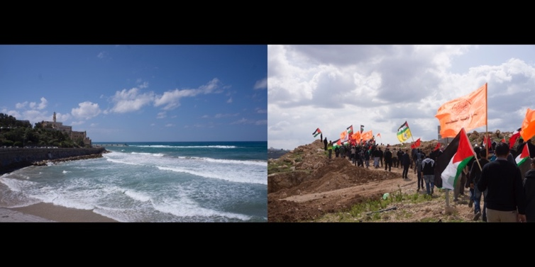
L: View of the ancient port city of Jaffa from Tel Aviv
R: Protestors in Bil’in, a village in the West Bank
Notes:
Watching Annemarie Jacir’s film, THE SALT OF THIS SEA, I learned that on a clear day you can see the Mediterranean from the West Bank city of Ramallah. This de facto administrative capital of the Palestinian Authority is only nine miles from Jerusalem and 28 miles from Tel Aviv.

Slide 28
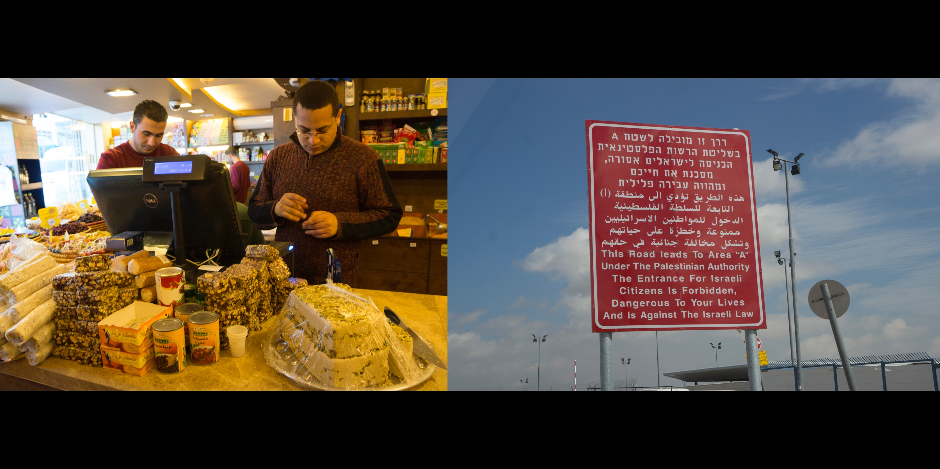
L: A spice store in Ramallah
R: Qalandia checkpoint in between Jerusalem and Ramallah

Slide 29
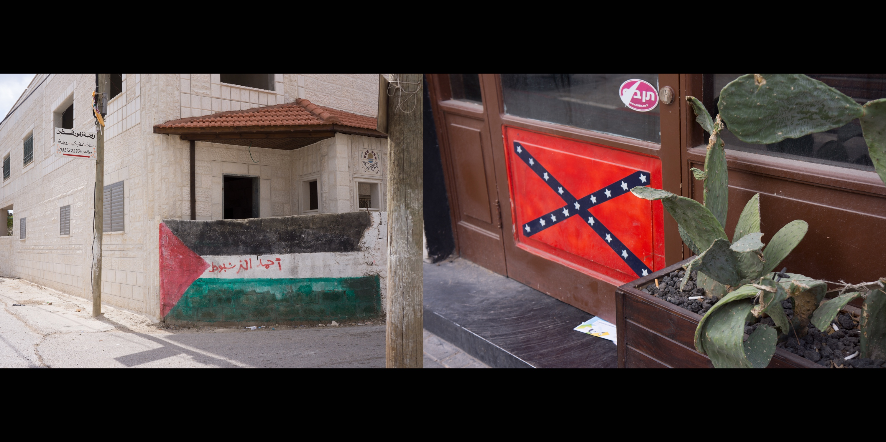
L: Seen on the way to Bil’in, West Bank
R: The Rebel Bar, Neve Tzedek, Tel Aviv
Notes:
The graffiti on the Palestinian flag is a tag. The name reads “Ahmad al-Narshabut.”
Since 9/11, police from New York, Ferguson, Baltimore, Los Angeles, Seattle, and other cities have traveled to Israel to receive training from the Israeli military on methods of crowd control and surveillance.
When Michael Brown, an 18 year old African-American man, was killed by police in Ferguson, Missouri, unarmed participants in the Movement for Black Lives protesting the shooting were met by a local police force and National Guard fully armed with riot gear that included armored vehicles, tear gas, stun grenades, rubber bullets, and semiautomatic rifles.
Upon hearing news of the unrest in Ferguson, Palestinians across Gaza and the West Bank took to social media to express support. They tweeted, “From Gaza to Ferguson, much respect and love.” “Remember to not touch your face when teargassed or put water on it. Instead use milk or Coke!,” and, “The tear gas used against you was probably tested on us first. No worries, stay strong.”

Slide 30
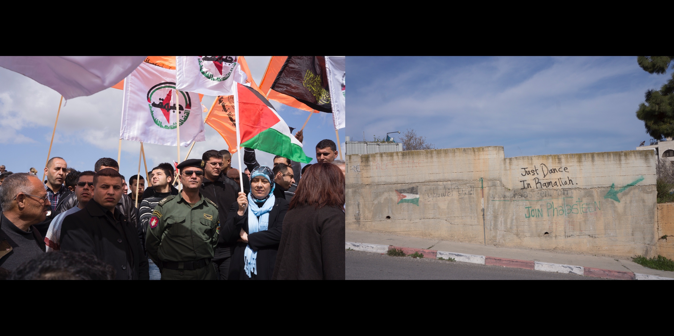
L: A Palestinian Authority police soldier and dignitaries in Bil'in
R: Graffiti in Ramallah
Notes:
The West Bank is divided into three, non-contiguous areas. Area “A” includes most Palestinian cities and towns such as Ramallah and Hebron. It is under Palestinian Authority (PA) civilian and security authority. Area “B” includes Palestinian rural areas such as Bil’in, and is under PA civilian authority and Israeli security. Area “C,” which makes up 60% of the land and includes valuable water sources, agricultural land, and Israeli built infrastructure, is under complete Israeli control.
In reality, Israel controls the entire West Bank. The borders are strictly patrolled—Palestinians do not have authority over who and what can enter the West Bank in any area. Israeli soldiers can enter at any time, and Israeli checkpoints located throughout the West Bank restrict movement between and within all areas.
I did not realize how rare and dangerous it was for an armed PA police officer to be seen in Bil’in, which is controlled by Israeli military forces.

Slide 31
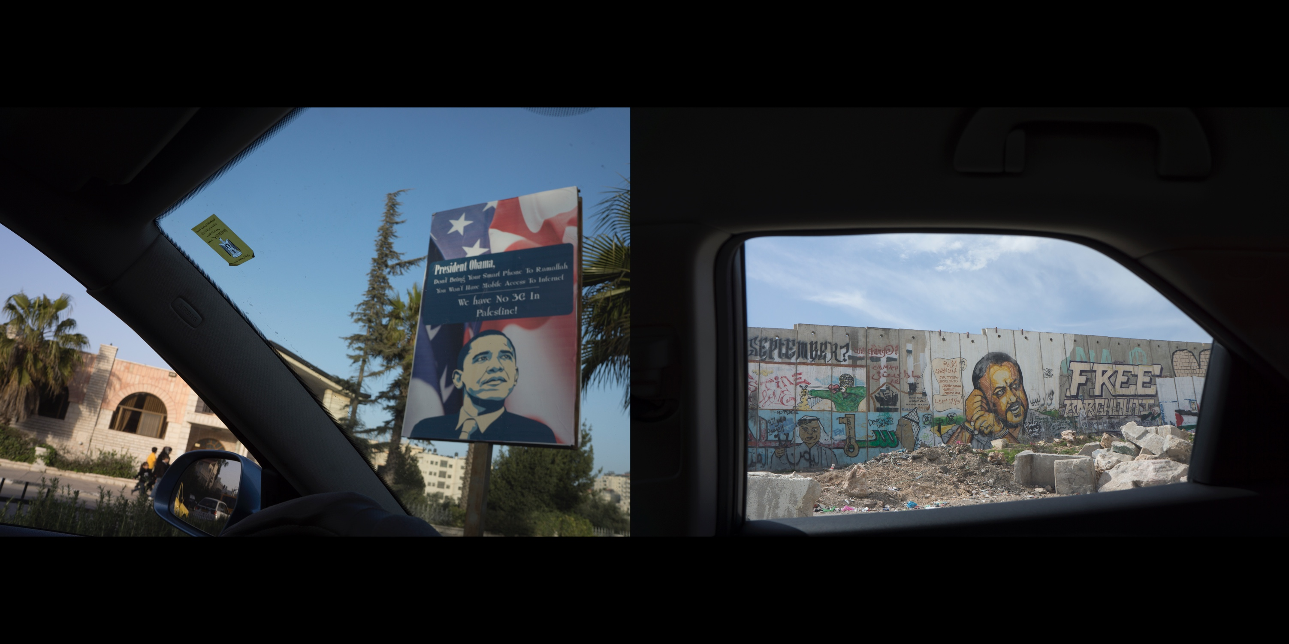
L: Poster protesting the lack of infrastructure in the West Bank during President Obama's visit to the
occupied territories, Ramallah
R: Graffiti image of Palestinian political leader Marwan Barghouti, who is serving five life sentences
at Ofer prison, near Qalandia checkpoint

Slide 32
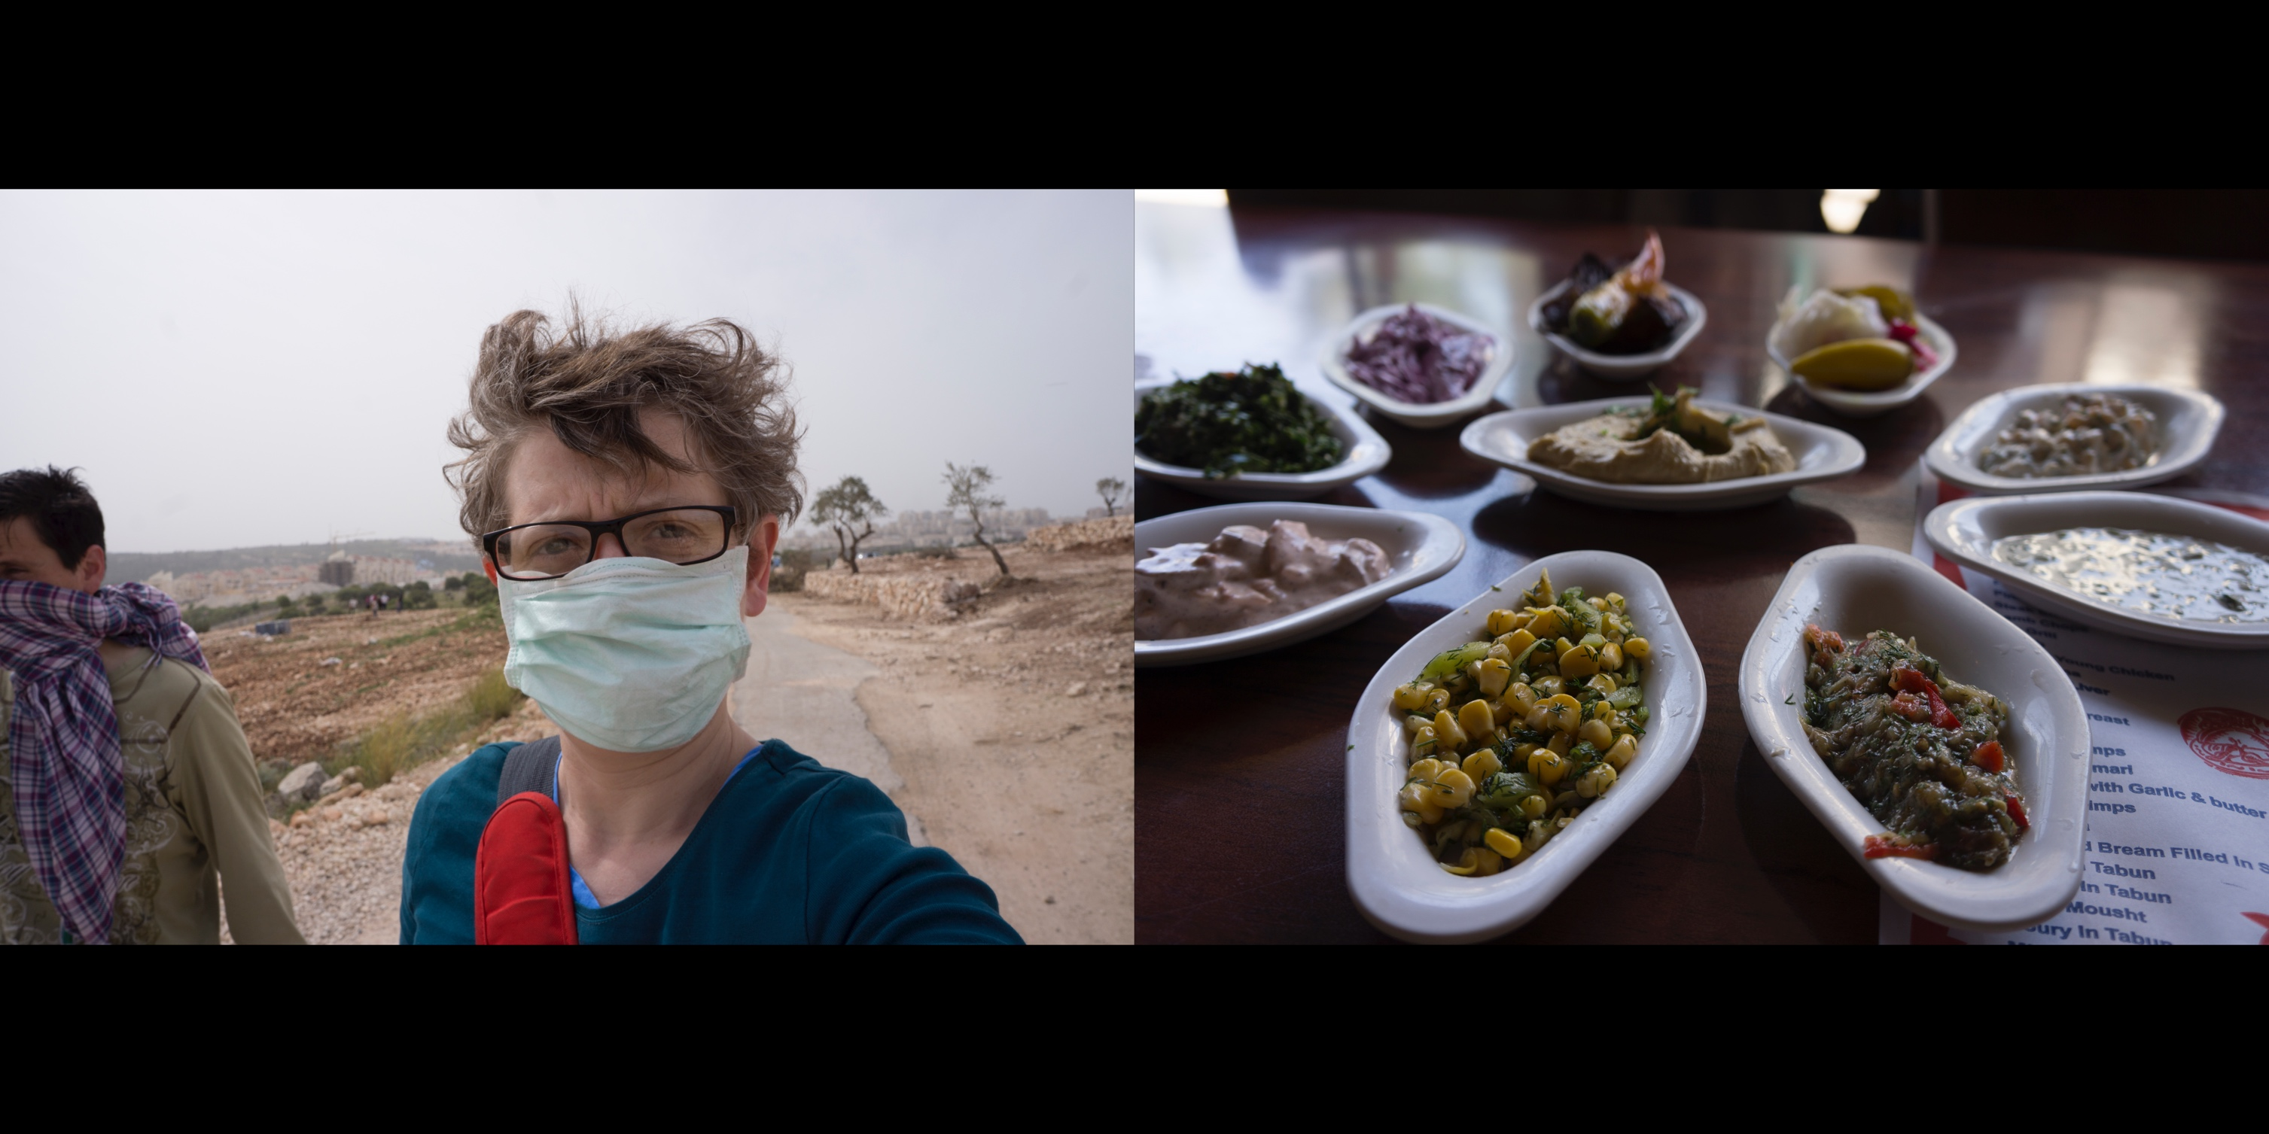
L: Tear Gas in Bil’in
R: Food in Jaffa, an ancient port city just south of Tel Aviv
Notes:
My good friend, Anne Cremieux, visited me during my trip. We met in Austin years ago when she was a visiting film professor at the University of Texas. She also works as a professional translator, creating subtitles for films. We are good travel partners and once took a road trip across France and Italy. Anne talked about grammar and gendered hierarchies in romance languages and I chose the music as we drove through the Alps to Milan, Florence, Marseilles, and back to Paris.
It’s a relatively short flight from France to Israel. Being an academic and part Jewish, Anne wanted to see Israel / Palestine for the first time. When we first spoke about her visit, we talked about the gay clubs and swimming in the Mediterranean.
By the time Anne arrived I had set up interviews and meetings across the north and south of Israel, and in Ramallah and Bil’in in the West Bank. Resting on the cold steps of Jerusalem, in our scarves and jackets, she said she was grateful for the experience. She saw what she otherwise would have never seen. It was kind of like when I chose to go to the eye doctor with her in Paris instead of the Eiffel Tower, except totally different.

Slide 33
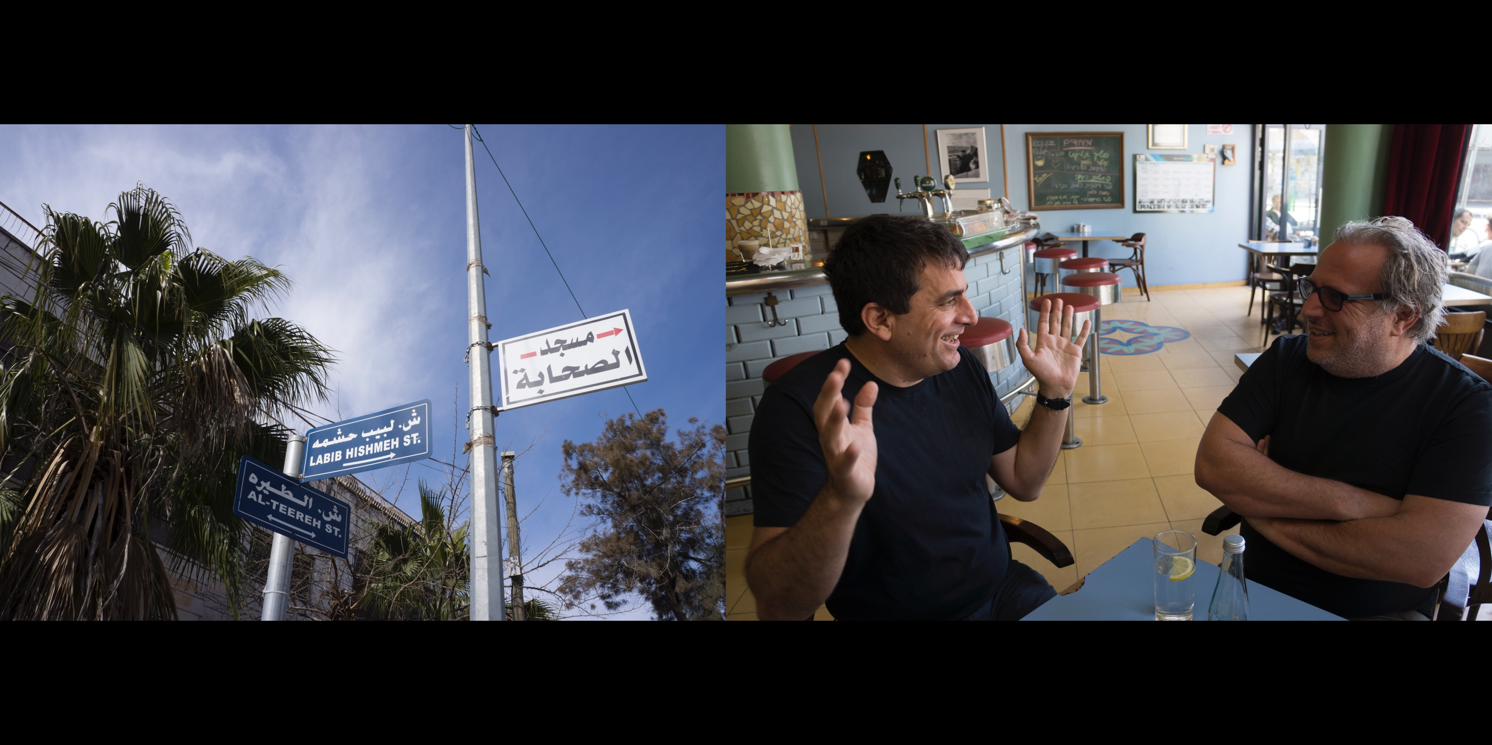
L: Street signs in Ramallah
R: Israeli filmmakers Dror Moreh (THE GATEKEEPER) and Udi Aloni (FORGIVENESS,
ART/VIOLENCE, JUNCTION 48), Café Bialik, Tel Aviv
Notes:
Filmmakers Dror Moreh and Udi Aloni are as ideologically opposed as they could possibly be and still be a part of Israel’s liberal left.
Moreh’s film, THE GATEKEEPERS, features a series of unprecedented interviews with former directors of Shin Bet (Israel’s CIA) who recount, one by one, the mistake it has been for Israel to use targeted killings and torture to achieve its security goals. Aloni, who supports the Palestinian call for boycott and no longer accepts Israeli state funding for his films, and who is known for his friendship and collaborations with Marxist philosopher Slavoj Žižek, argues that THE GATEKEEPERS legitimizes war crimes. The former Shin Bet directors, he explains, admit their actions and face no legal consequences. They regret their actions because it did not help Israel, not because they were amoral acts that violate international law.
To Moreh, critiques like Aloni’s come from a radical leftwing that has its “head in the sky.” Moreh believes that Shin Bet leaders were acting to protect Israel and preserve a Jewish homeland. Tragically, by over relying on security and defense to keep Israel’s enemies in check instead of vigorously pursuing political policies and solutions, Israel’s defenders instilled hatred on both sides, and now Israel’s democracy and safety is crumbling. Whereas Moreh sees the cracks in Israel’s democracy, Aloni believes a true democracy never existed. Whereas Moreh sees the war of 1948 as a war of independence, Aloni views it as the “Nakbah,” or catastrophe, in which 700,000 Palestinians were driven from their homes.
Although activists like Aloni consider Moreh to be conservative, Israel’s rightwing balked at the film calling Moreh a traitor. The Minister of Culture, expressing dissatisfaction with films like THE GATEKEEPERS and 5 BROKEN CAMERAS, called on filmmakers like Moreh to “censor themselves.”
I interviewed both men at Café Bialik in Tel Aviv. My interview with Moreh ran a little long and Aloni showed up on time, initiating a rare meeting between the two men. Commenting on the 3-D modeling and other sophisticated graphics in THE GATEKEEPERS, Aloni tells Moreh, “Politics aside, man, you made a fucking great film.”

Slide 34
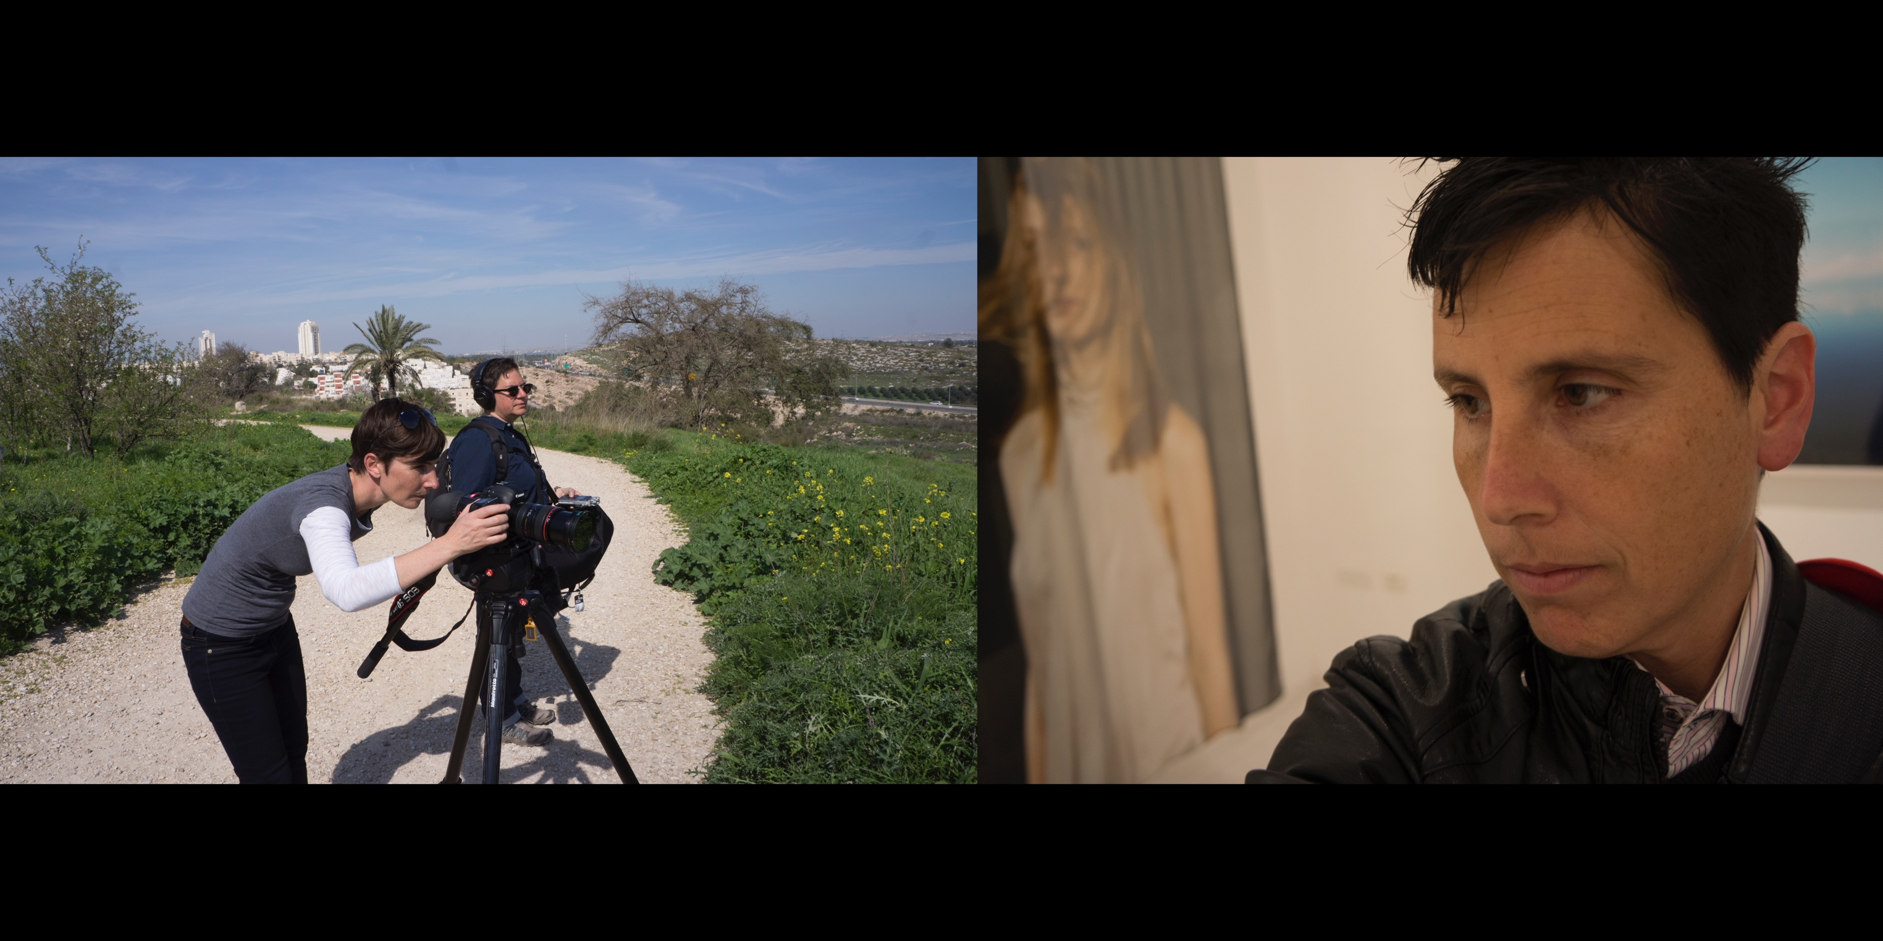
L: Canadian filmmakers Elle Flanders and Tamira Sawatzky, shooting a disappeared Arab
village for their project, “What Isn’t There”
R: Selfie taken at a friend’s gallery in Neve Tzedek, Tel Aviv
Notes:
I first met Elle Flanders in 1999 at the Toronto Gay & Lesbian film festival, “Inside Out.” She was the executive director of the festival at a time when gay and lesbian films were stigmatized and marginalized. Flanders directed the event as if it were Sundance or the Toronto International. She did not try to win interest or convince the industry to be a part of it. She presumed their participation, without question.
Flanders and others led the movement to include Queers Against Israeli Apartheid (QuAIA) in the Toronto gay and lesbian pride parade. The group’s efforts generated great controversy and a movement by City Council to de-fund the parade. QuAIA argued that the Israeli government promotes its liberal policies on gay and lesbian rights and tries to attract LGBTQ tourism in order to deflect criticism of the government’s treatment of Palestinians. Members also drew connections between queer progress and anti-colonialist and anti-racist movements.
Flanders’ award winning documentary, ZERO DEGREES OF SEPARATION, was the first to examine queer identity in Israel/Palestine through the lens of the Occupation.
Flanders and Sawatzky showed me how to get to Ramallah, and I returned two more times on my own.
------------------
Many young Jews from the US and other places around the world first visit Israel through an organization known as “Birthright,” which seeks to “ensure the future of the Jewish people by strengthening Jewish identity, Jewish communities, and connection with Israel.” Every year the program gives hundreds of Jews between the ages of 18-26 a free seven to ten-day trip to Israel. The program was co-created by Elle’s uncle, the billionaire philanthropist Charles Bronfman.
––––––––––-
Dean Spade’s 2015 film, PINKWASHING EXPOSED, documents how several queer Palestine solidarity activists successfully lobbied the City of Seattle’s LGBT Commission to drop an Israeli-government-supported tour featuring gay and lesbian activists who were to visit the area. The political fallout that occurred from the mainstream Jewish community calling the act antisemitic is still being felt today.

Slide 35
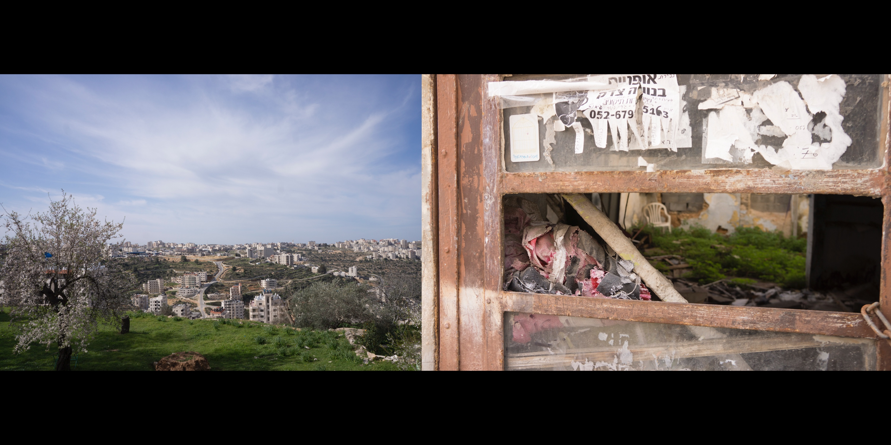
L: Suburbs of Ramallah
R: Neve Tzedek, Tel Aviv

Slide 36
Israel/Palestine: An Act of Seeing
CREDITS
Images & Text…………....……………...............Mocha Jean Herrup
Media Specialists...........................................Seth Dahl, Kari Rosenfeld
Copy Editor…………………………..…........…....Katie Pace
Additional Research………………..................Batya Hecker, A.R. Tripp
Additional Photography…………….…….....Anne Cremieux
Thank You
Sinai Abt- Al Quds University, Ramallah – Sia Alper - The Austin Community College- Dr. Lawrence Afrin - Ra'anan Alexandrowicz - Udi Aloni- Austin Interfaith Community for Palestinian Rights - Ori Bader - Amad Barghouti - Moheeb Asad Barghouti - Dalit Baum - Tallie Ben-Daniel – Blick Art Materials- Pascal Bos - Ramona Brown - Emad Burnat - Celeste Chan - Heather Courtney - Anne Cremieux - Guy Davidi- Digital Services Bureau for Learning at the University of Minnesota - Masha Dion - Etai Eisenger - Peggy Ellithorpe - Haitham El-Zabri - Avner Faingulernt - Audrey Ferrie - Friends Meeting of Austin- Elle Flanders - Jett Garrison - Lisa Geduldig - Rachel Gold - Mahala Guevara - Craig Harris - Karen Haselmann - Barak Heymann- Tomer Heymann- Yair Hochner- Oree Holban - Lauren Holtzman - Philip Hopper - Dorit Ingbar - Nachman Ingber- Jewish Voice for Peace Austin, Bay Area, Twin Cities, and the national campaign to End the Deadly Exchange - Carrie Kenny, Prizer Gallery - Susan Horwitz- Rachel June - George Khleifi - Shirin Khosropour - Eran Kolirin - Evie Leder - Gretchen Lee- Michael Mayer- Dror Moreh - Yariv Mozer - Abed Natour - Erez Laufer- Claudia Levin- Madeline Levine - Katriel Schory- Pauline Martin- Kiki Luv - Ziv Naveh- Deb Norris - Lucy Nusseibeh- Lynda Pavak – Pam Peniston - Alon Pdut - Yael Perlov- Sawsan Qaoud - Yair Qedar- The Qulture Collective - Dr. Mark Renneker - Arielle Rosen - Saul Schaul- Katriel Schori- Sherwood Housing Cooperative - David Silber - Kobi Snitz- Texas Starr - Jenn Steinfeld - My friends in Arizona and Pacific Grove - Illana Rossoff - Tali Shapira - Tamira Sawatzky - Dean Spade - Lia Tarachansky- November Wanderin - Kate Ward - Alesia Weston - Devorah Winegarten - Jess Weida – Reba Wirtel- Yasmin
For my cousin, Elaine Cantor Fischer, I wish you were here.

